Slide 1
SQL (Basic)
Vanessa Casillas
Graduate Fellow

Slide 2
Before we start
Download
DbeaverSqliteGUI environment
https://dbeaver.io/
Download and install Community version on local machine (installer available for Windows, Mac and Linux)
Survey
https://github.com/CMC-QCL/SQL

Slide 3
Agenda
SQL Overview
Relational Databases
Databases
Basics SQL Commands Demo
Resources
SQL Database Query Difference
Operation Order
Activity
Contact Info
Answers
Basic SQL Statements
Notes:
Edminer.

Slide 4
If you want to…
See data
Relationship between data
Find any cell
Add data to cells
To add order to information

Slide 5
SQL Overview
Structured Query Language
Crud: create, read, update, delete
Create databases and tables
Look at specific data
Make changes to data and remove data
And more (level 2)
Notes:
SQL is acronym for Structured Query Language
Language specifically designed to access and work with relational databases
Relational databases are databases that store and provides access to data points that are related to one another. Relational databases are based on the relational model, an intuitive, straightforward way of representing data in tables.
Databases need a method for accessing their content, manipulating and retrieving the information
These methods called database language
SQL is the most common and widely uses language for accessing and interacting with databases
Originally developed in the 1970s at IBM
Original acronym –SEQUEL –Structured English QUEryLanguage
acronym changed to SQL because SEQUEL trademark belonged to British aircraft production company Hawker SiddeleyDynamics Engineering Limited (later part of British Aerospace, now BAE Systems)

Slide 6
Relational Databases
A collection of tables
Set of columns in each table and rows with data
Each row is called a record
Data between tables can be related between each other
Collection of tables is called schema
Notes:
We are surrounded by data
The current workshop has data about participants, their email address, what institution they are from
How do we store and organize the data?

Slide 7
Relational DBMS
Courses_Students
School_Courses
ID | ClassID | Semester
71225 | 1005 | Fall21
86634 | 1006 | Spr22
32238 | 1009 | Spr22
ClassID | Title | ClassNum
1005 | Intro to Art History | 500
1006 | Intro to SQL | 501
1009 | Intro to Datebases | 300
Students_Attendees
ID | Name | Grade | DOB
71225 | Lili | Freshman | 03/12/1995
32238 | Brenda | Senior | 05/28/1989
86634 | James | Freshman | 09/20/1999

Slide 8
The Relational Model
Primary Key
CustomerID | CustomerName | Status
1 | Instagram | Active
2 | Facebook | Active
3 | Myspace | Inactive
Row or Tuple
Rows are cardinality
Columns are degree
Table called a Relation
Column or Attribute

Slide 9
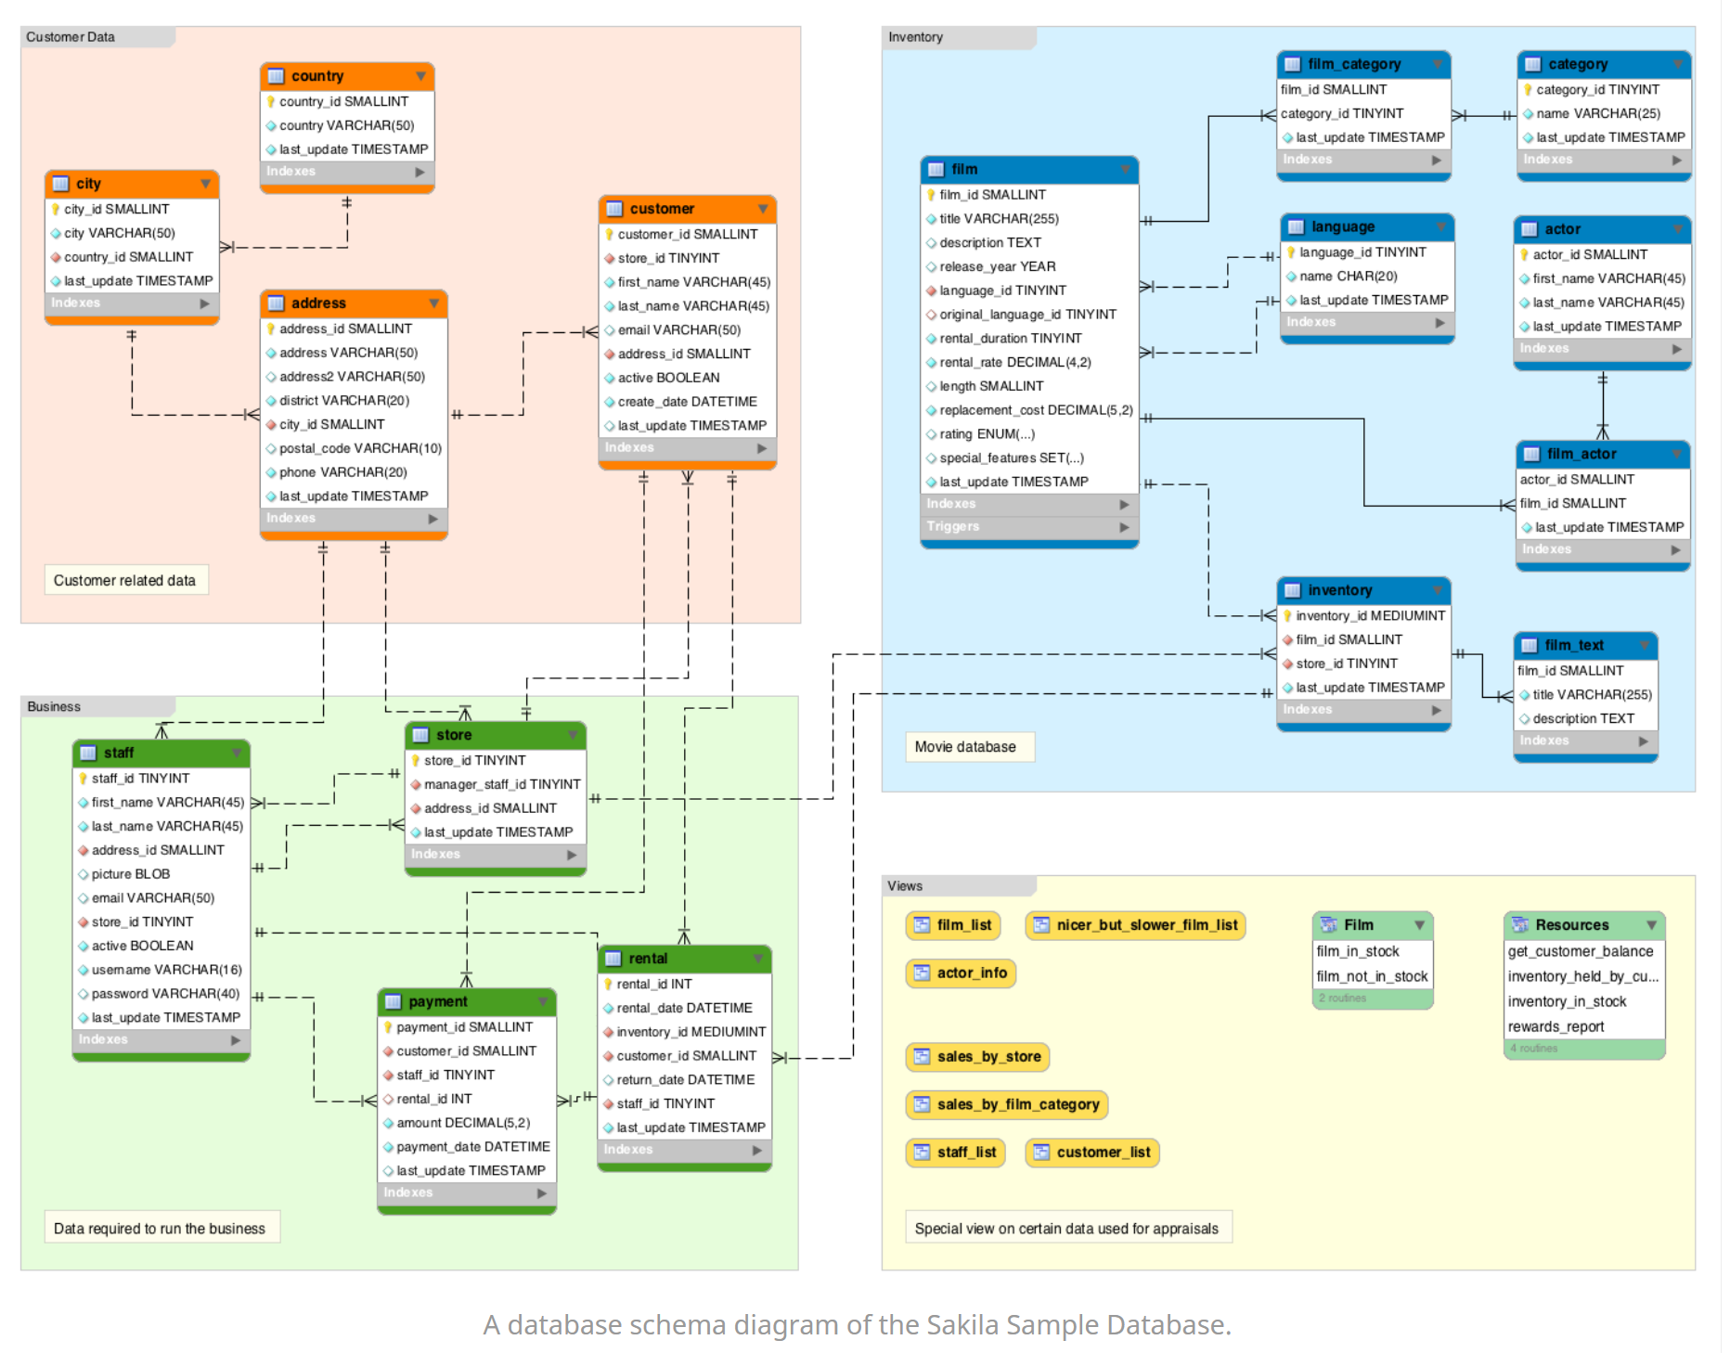
Schema Example
https://database.guide/what-is-a-database-schema/

Slide 10
Vocabulary
Data Definition Language (DDL):
CREATE, DROP, ALTER, TRUNCATE
Data Manipulation Language (DML):
INSERT, UPDATE, DELETE
Data Query Language (DQL):
SELECT, JOIN
Data Control Language (DCL):
GRANT, REVOKE

Slide 11
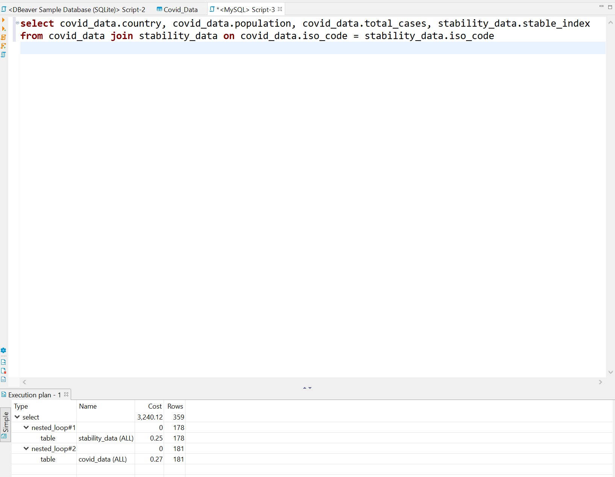
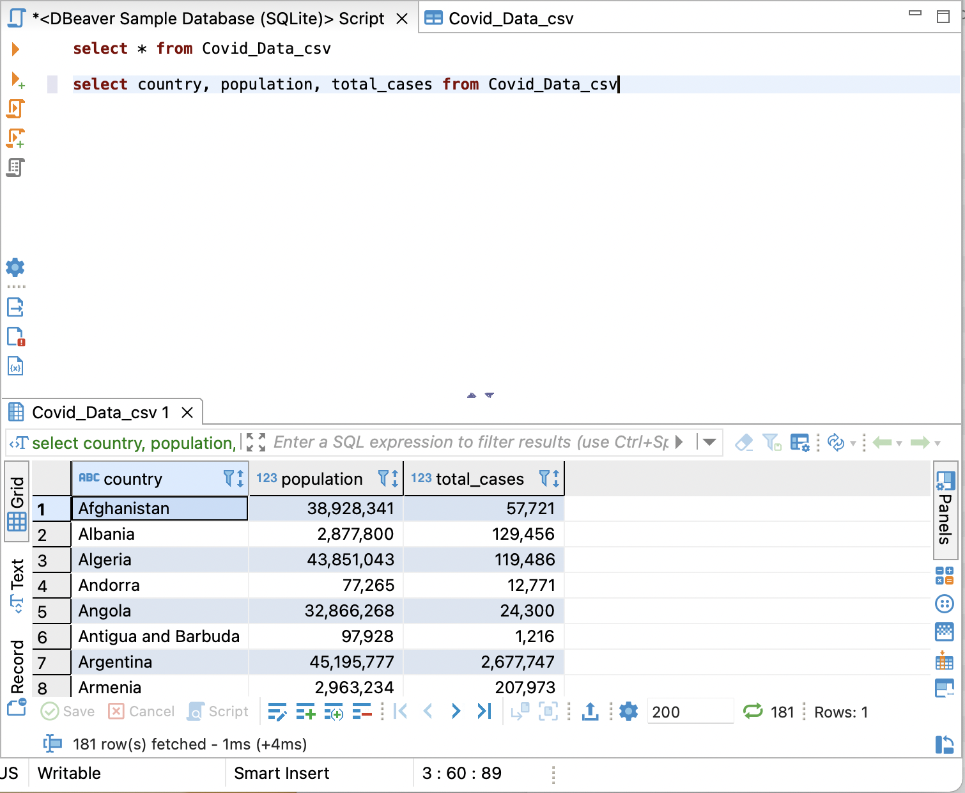
Basic SQL Statements
VIEW: virtual table
INDEX: users cannot see the index; it is used to retrieve data from the database more quickly

Slide 12
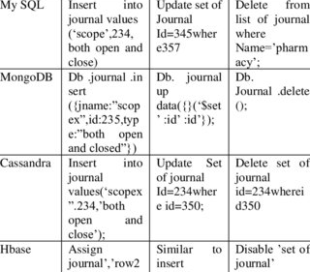
SQL Severs Syntax
Sqlite
MySql
Postgresql
Maria DB
Kumar, M. Sandeep, and Prabhu .J. “Comparison of Nosql Database and Traditional Database-an Emphatic Analysis.” JOIV : International Journal on Informatics Visualization, vol. 2, no. 2, 2018, p. 51., https://doi.org/10.30630/joiv.2.2.58.

Slide 13
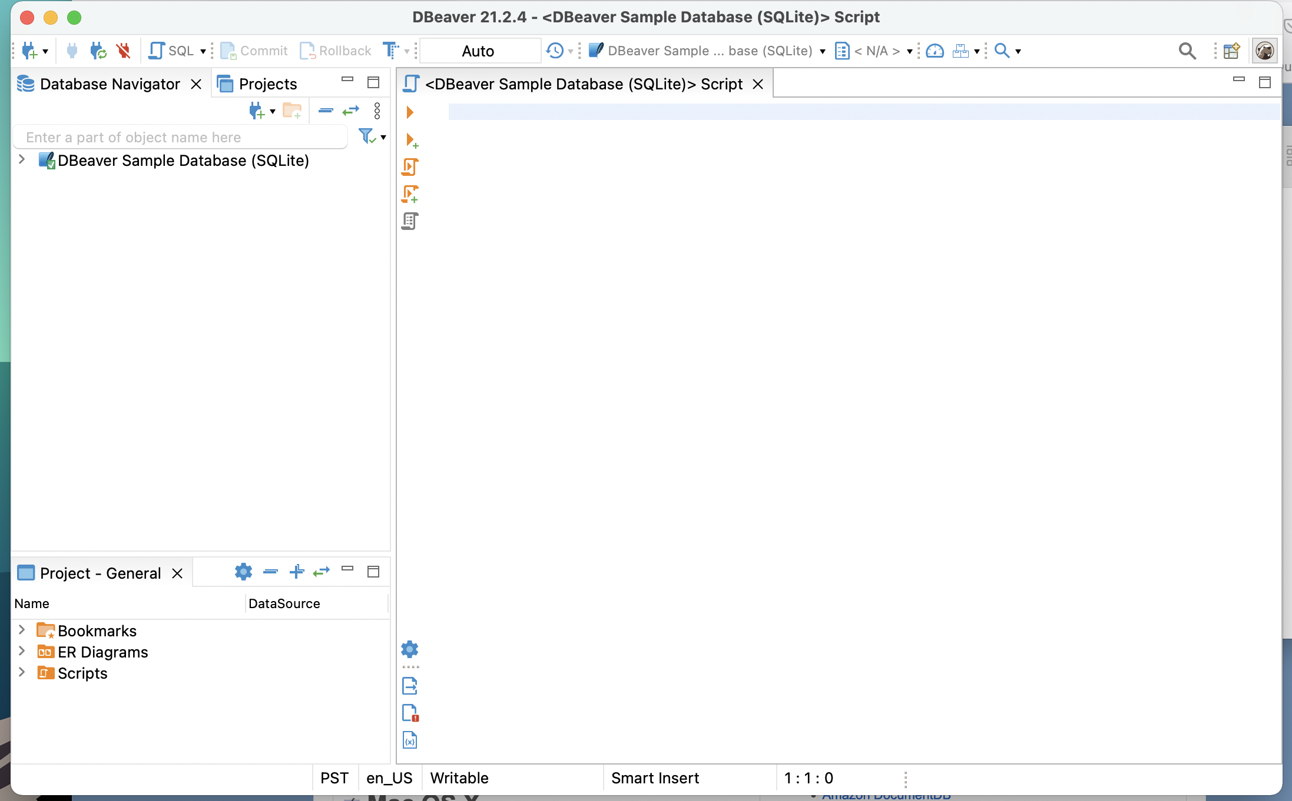
Interface

Slide 14
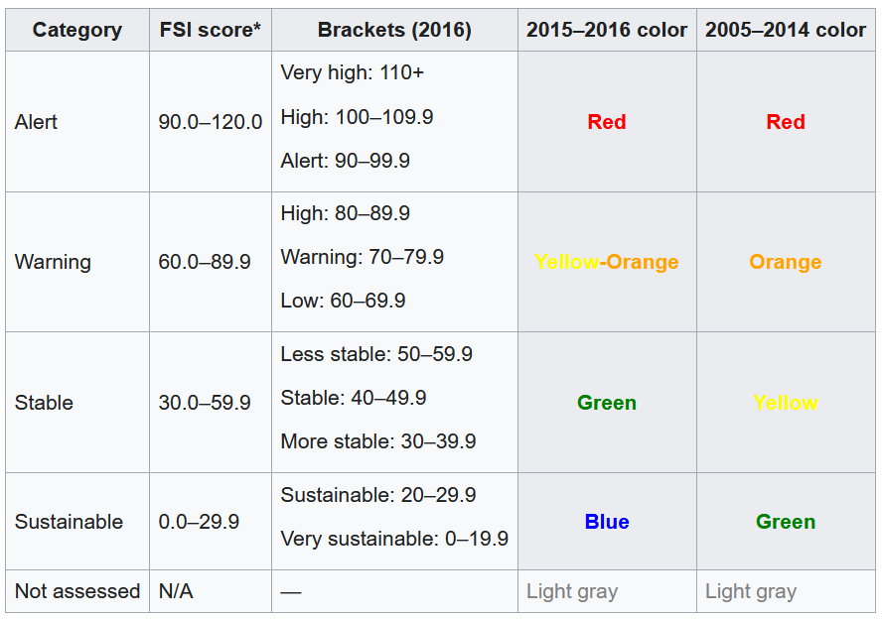
Today’s Data
Our World in Data (owid) on COVID by country and by continent
https://ourworldindata.org/
World Stability index data from Fund for Peace
https://fundforpeace.org/
https://en.wikipedia.org/wiki/Fragile_States_Index

Slide 15

Basic SQL Commands
Notes:
Make three different columns on each slide and an example (visual) in a simple matter.

Slide 16
Writing Query
Select – Returns the data that was requested
From – choose a table to draw information from
Join – matches records from different tables
Where – filters data bases on request
Group By – aggregates the data
Having – filers aggregated data
Order by – sorts the data
Limit – limit the number of rows returned

Slide 17
Demo Agenda
Import a data table called state_crime
Query using the SELECT statement with wildcard
Filter a query using the WHERE clause and ORDER BY
Create data table called state_computer_data
Insert state_computer_data from sql file
Relate the two tables using the JOIN connector make Alias
Aggregate Functions

Slide 18
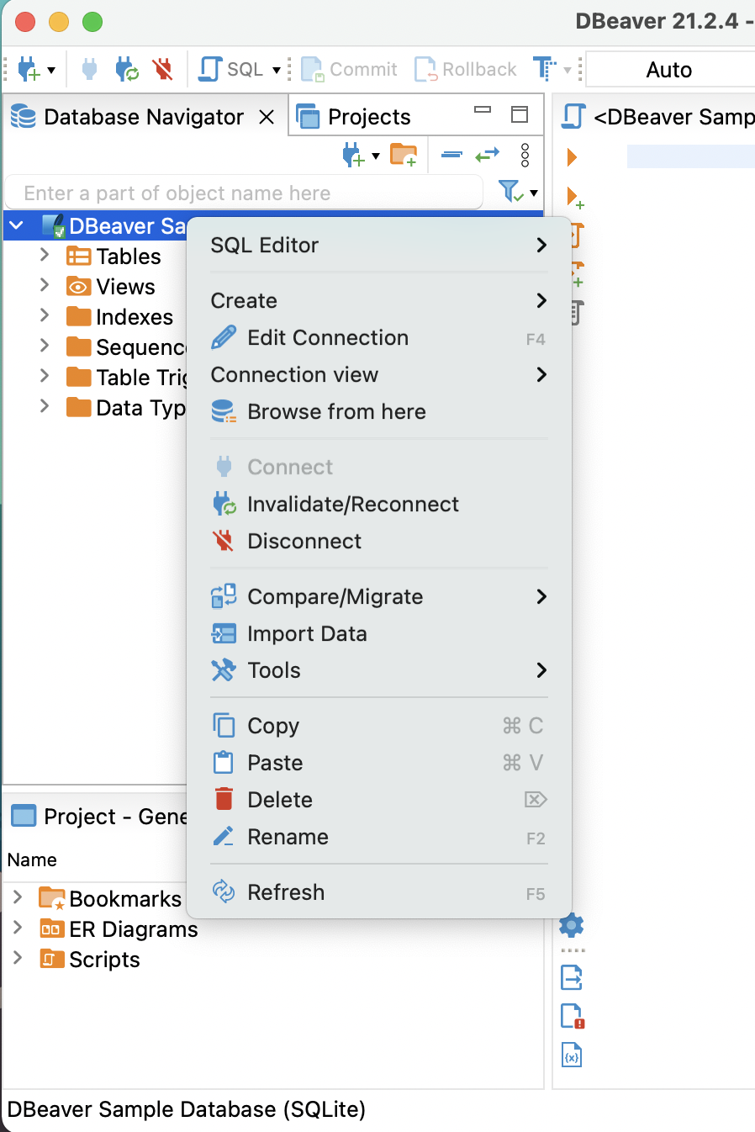
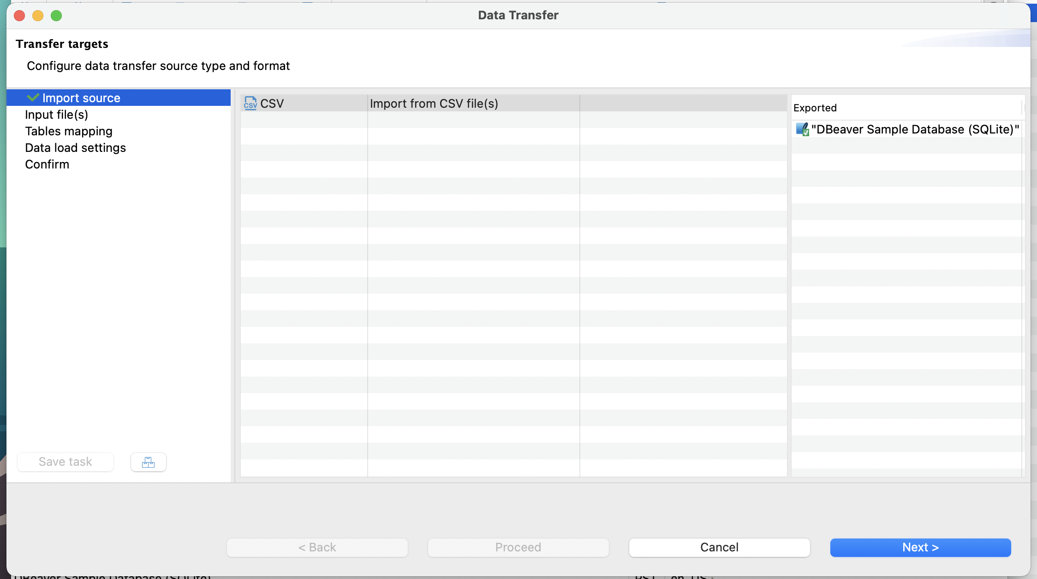
Import CSV

Slide 19
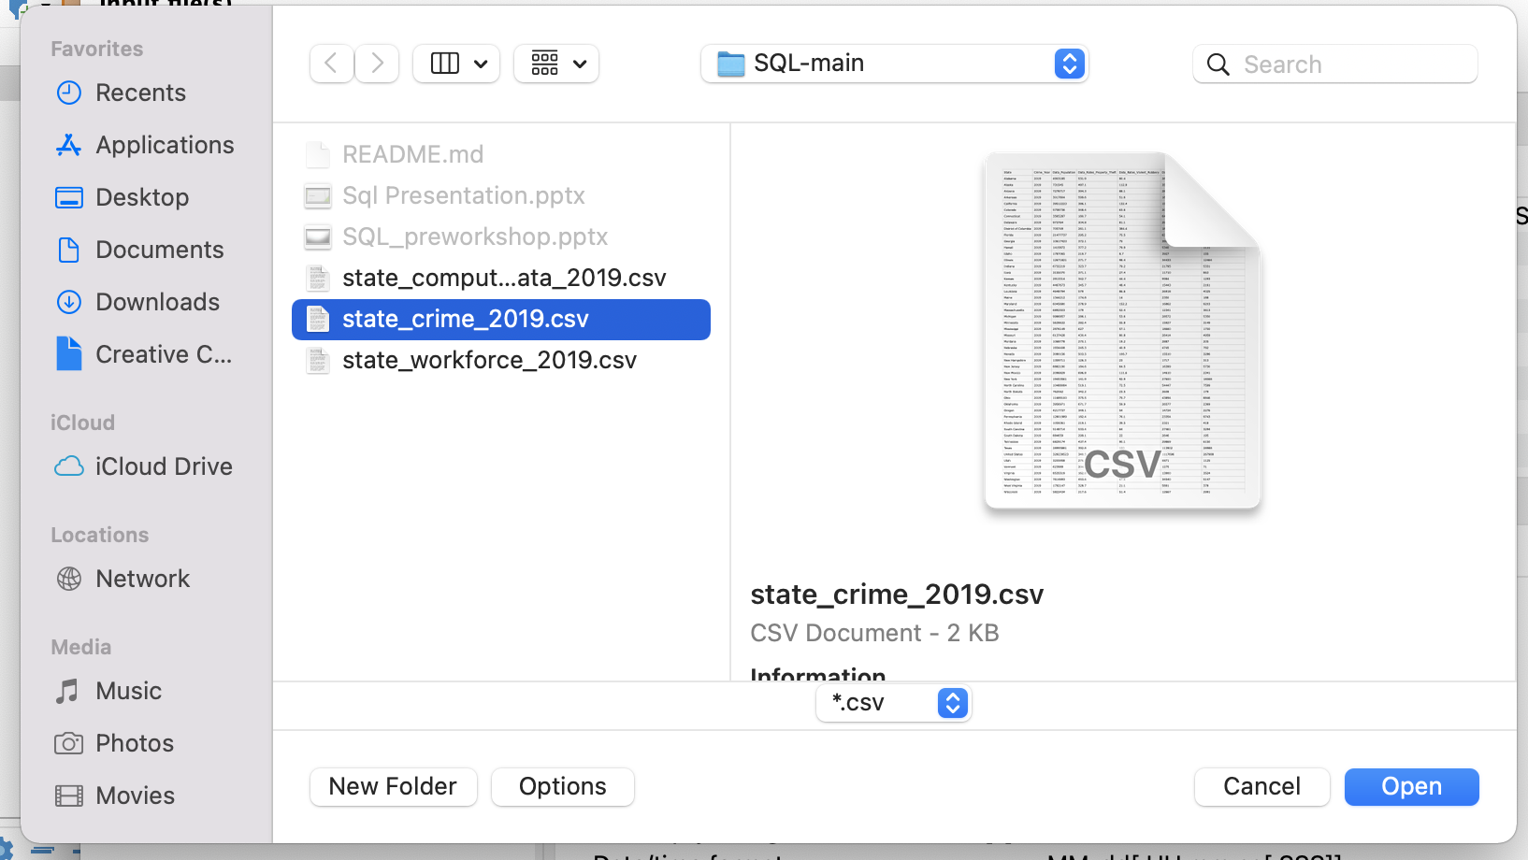
Import CSV (cont.)

Slide 20
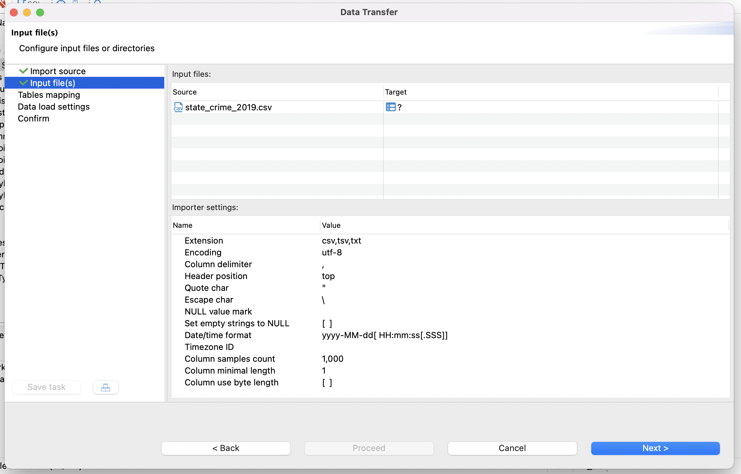
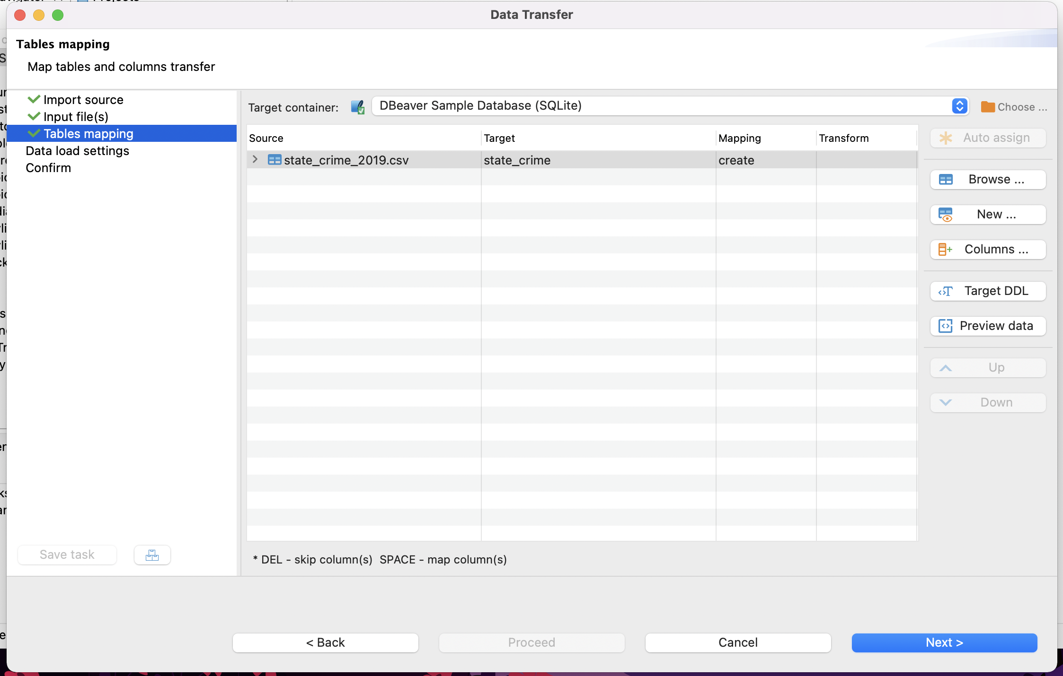
Import CSV (cont.)

Slide 21
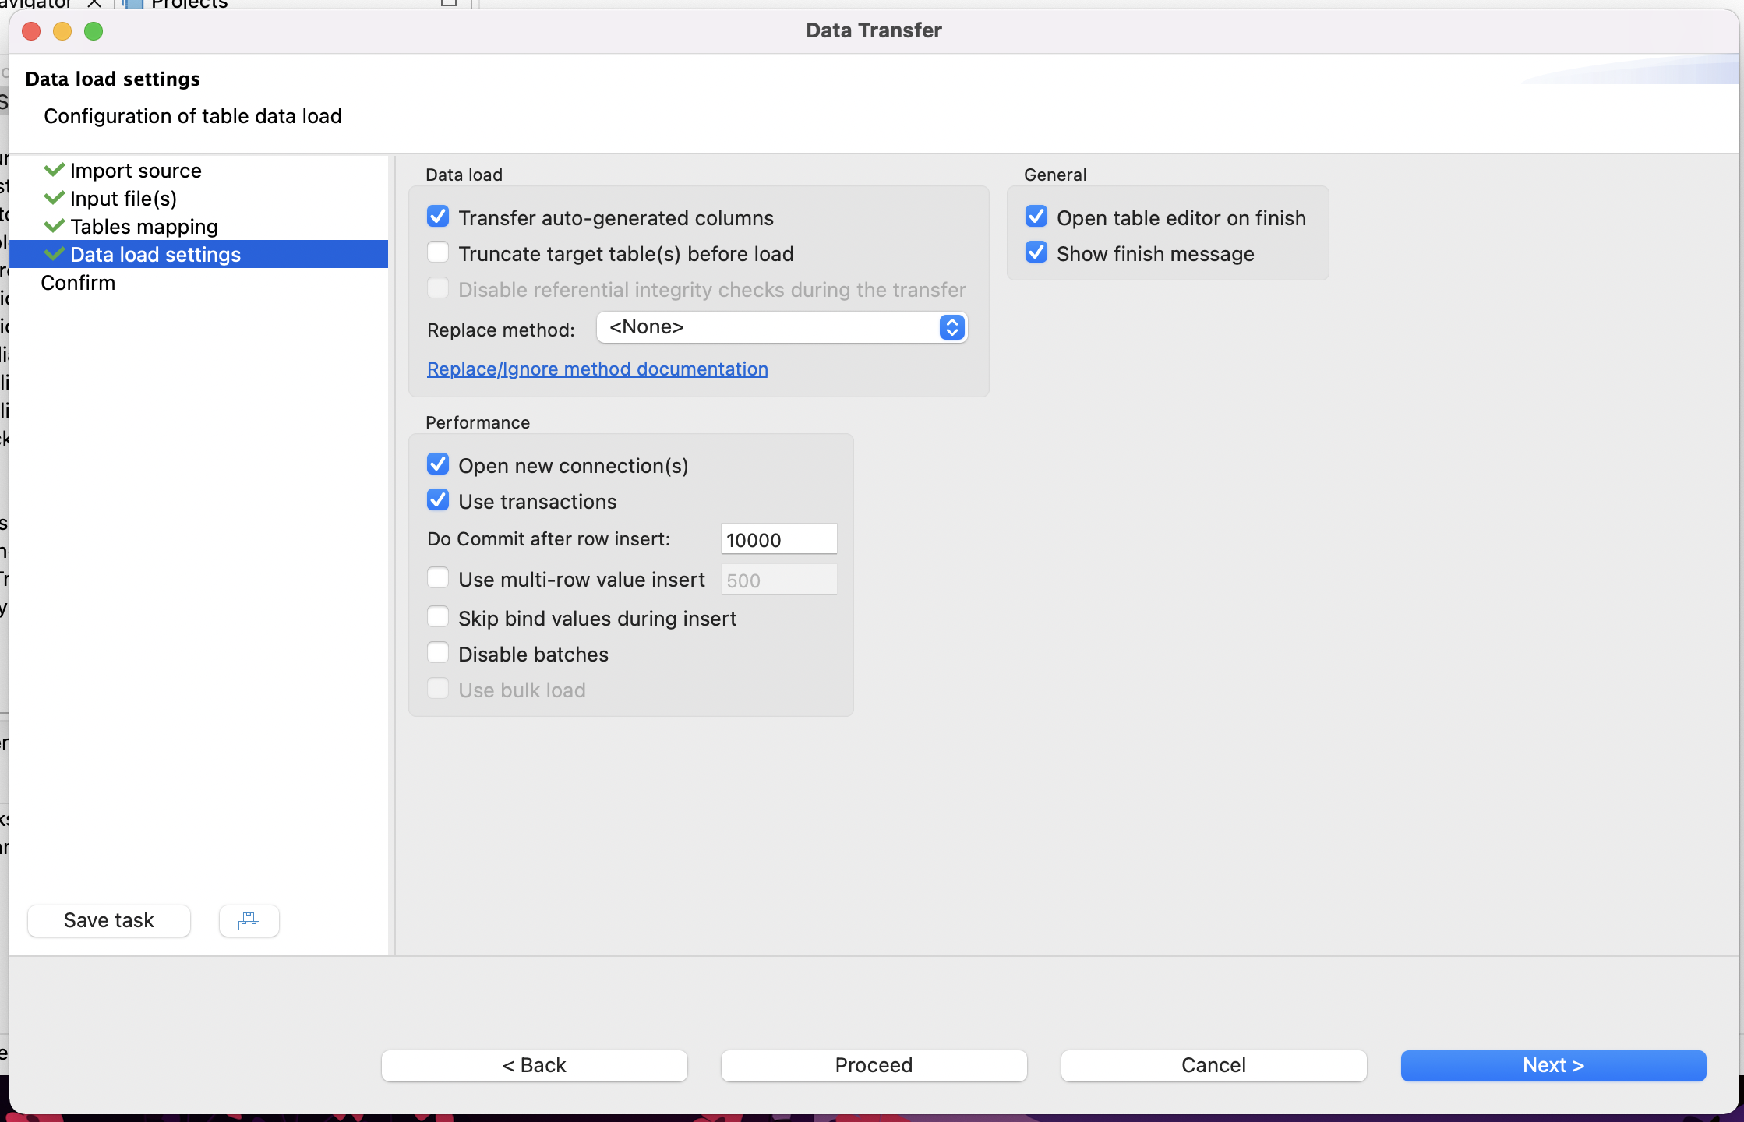
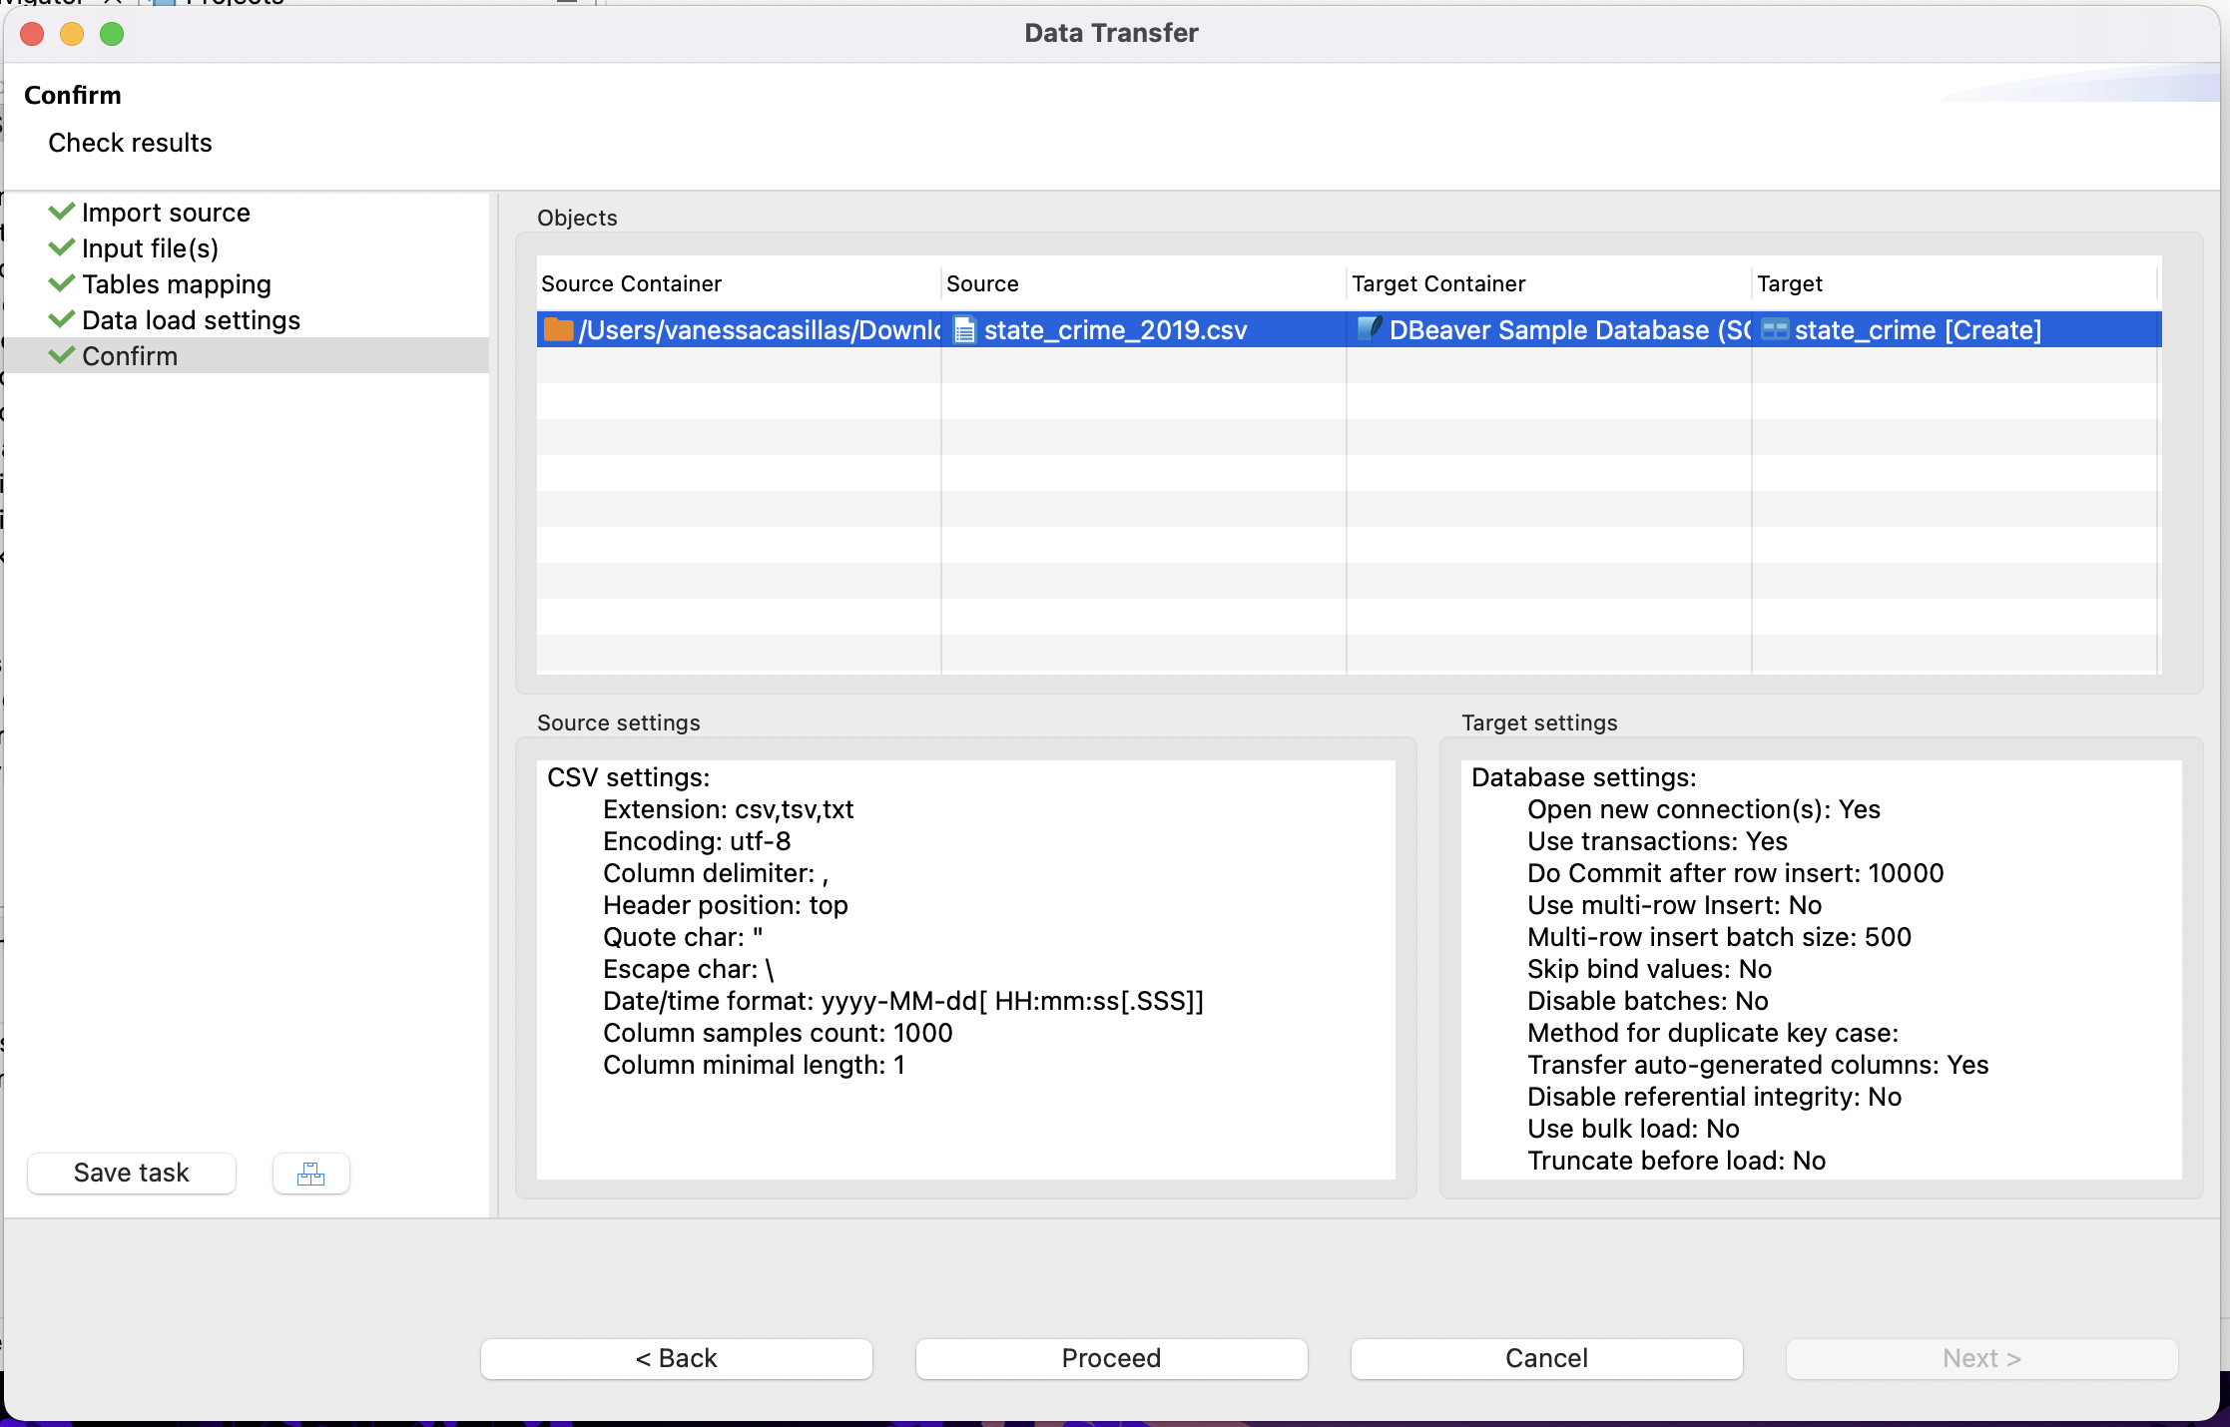
Import CSV (cont.)

Slide 22
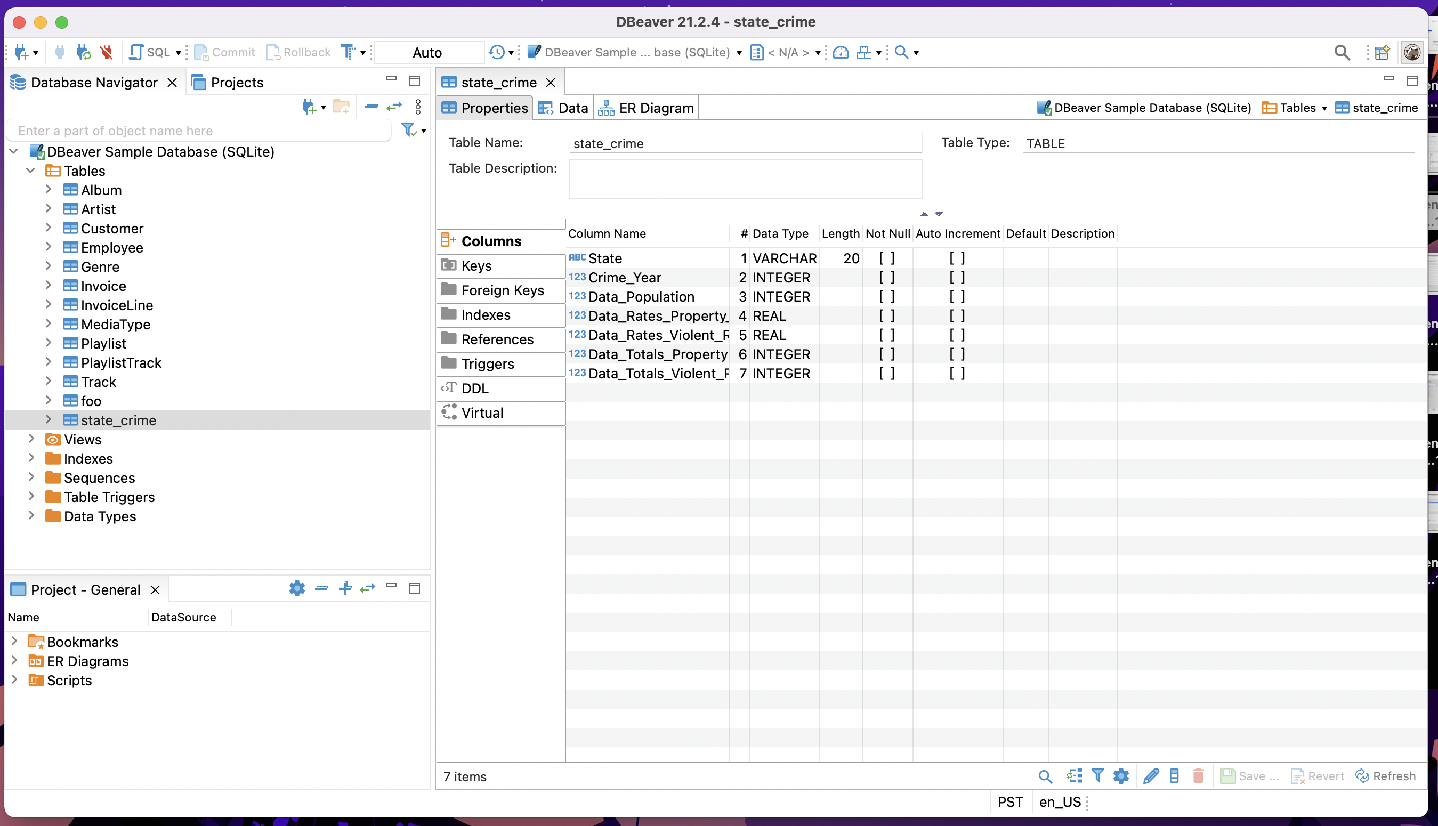
Successful Import of CSV

Slide 23
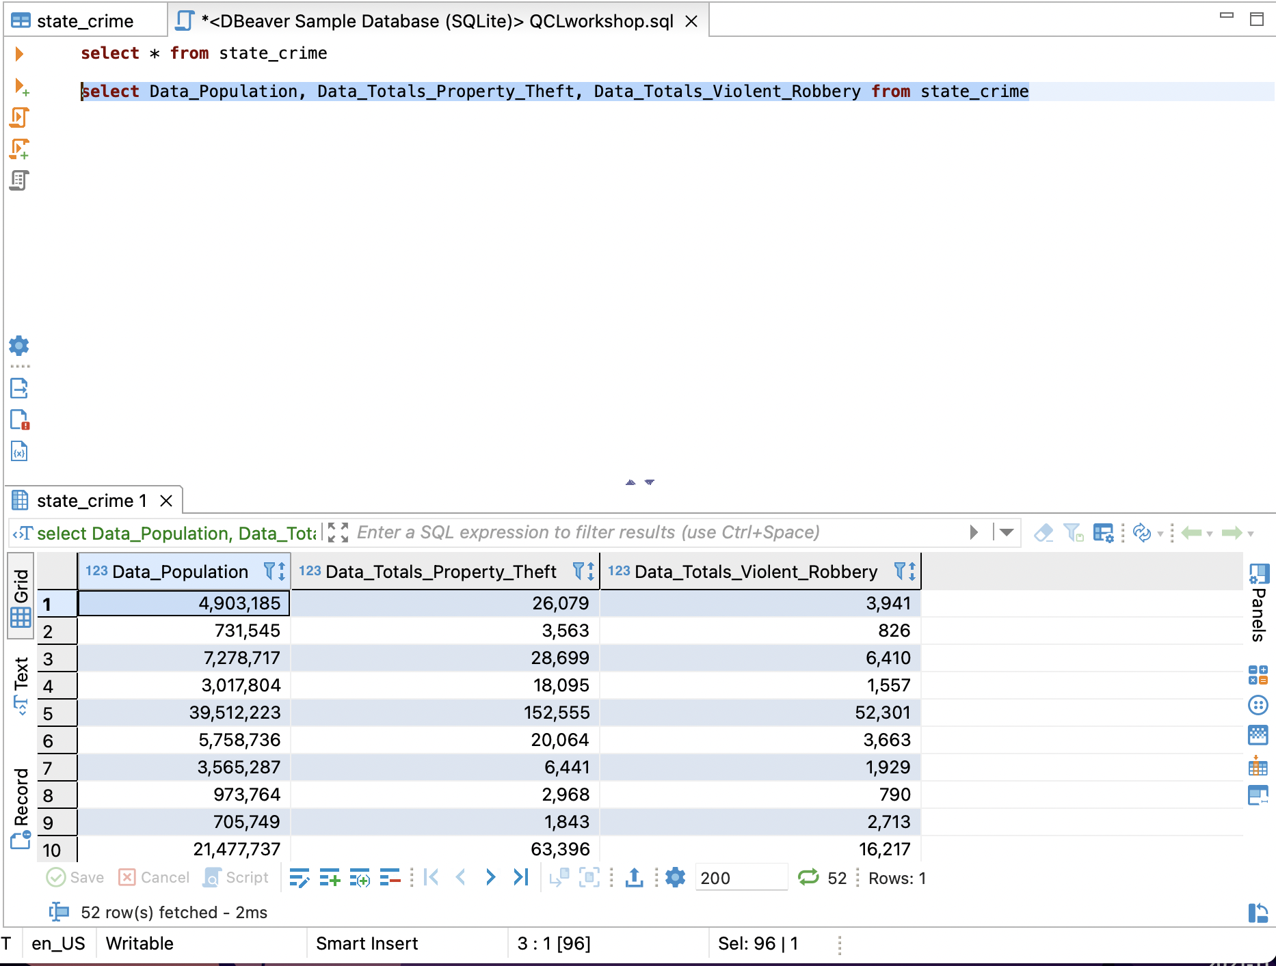
Select
select * from state_crime
Will show all the data within the table due to the wildcard
How many rows?
How many attributes?
select Data_Population, Data_Totals_Property_Theft, Data_Totals_Violent_Robbery from state_crime
Will show the columns that we like to see only
Notes:
DELETE:
Removes a row (or a group of rows) from a database
SELECT:
Selects certain columns from a table. A common part of most queries

Slide 24
Detailed view
SELECT column1, column2, ... FROM table_name;
*
:wildcard (select all)
select * from state_crime
select Data_Population, Data_Totals_Property_Theft,Data_Totals_Violent_Robbery from state_crime
Table name
What do you want to see?
Column names
what table?

Slide 25
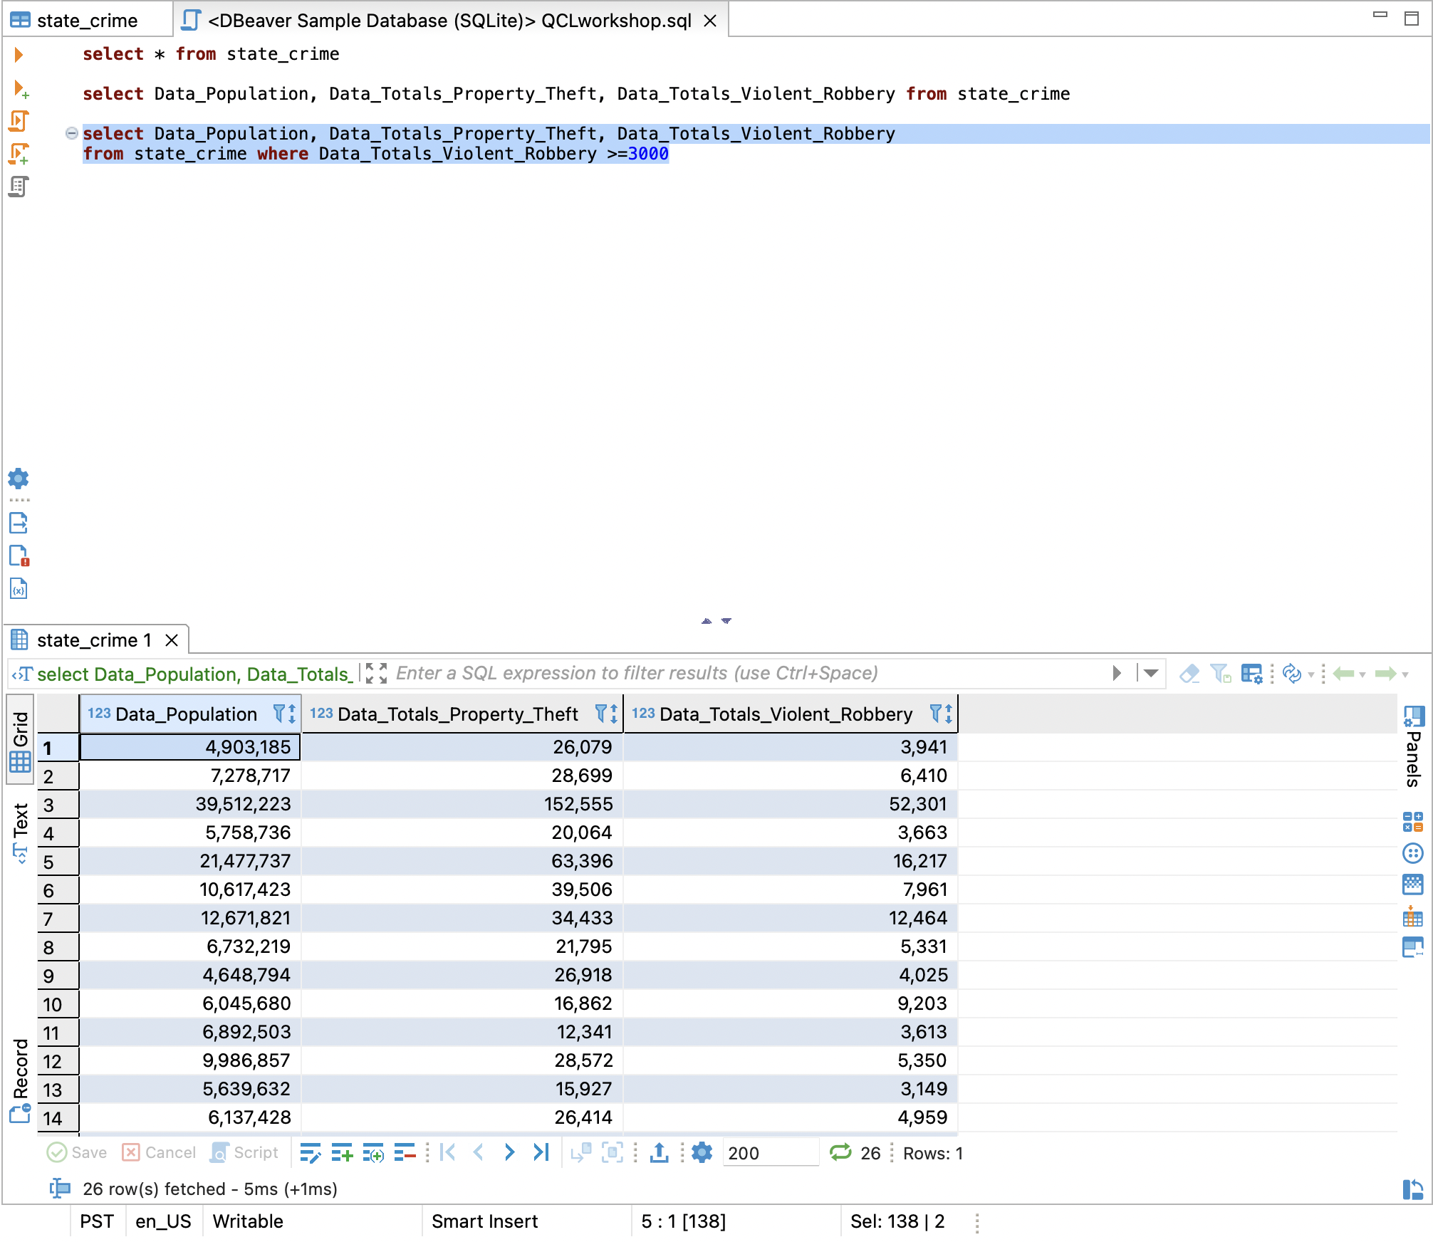
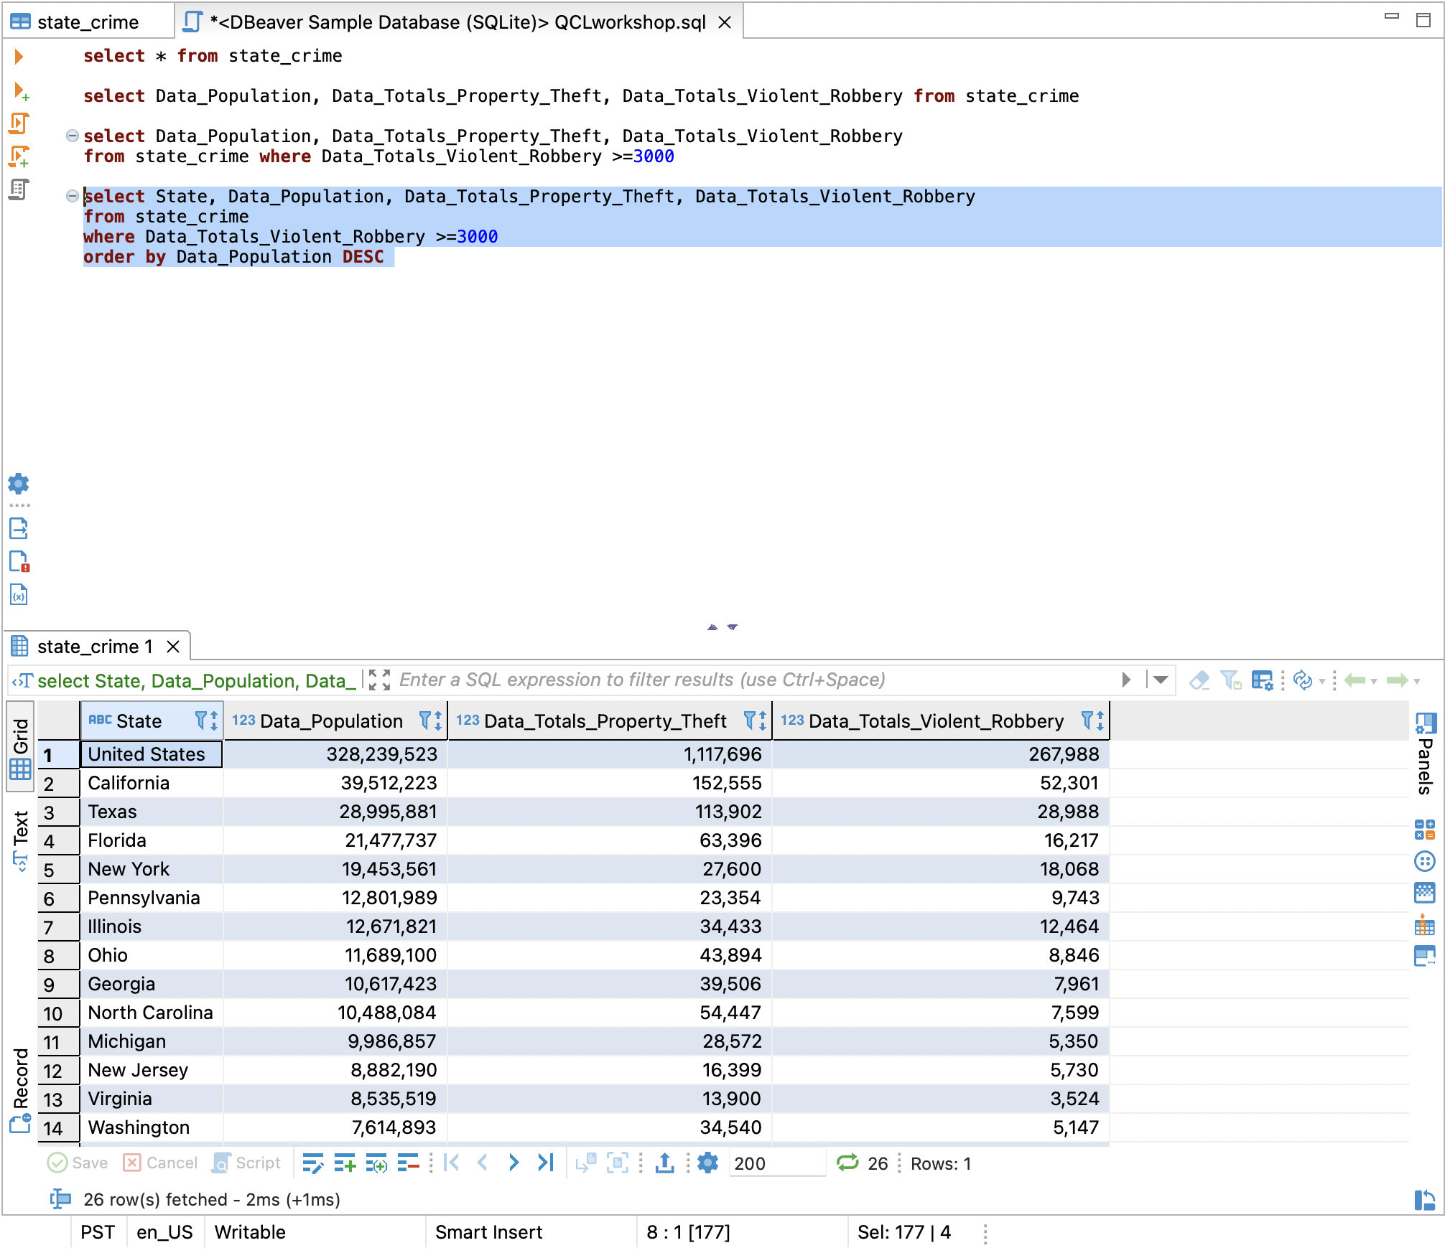
Where and Order by
select Data_Population, Data_Totals_Property_Theft, Data_Totals_Violent_Robbery from state_crime where Data_Totals_Violent_Robbery >=3000
select country, select State, Data_Population, Data_Totals_Property_Theft,Data_Totals_Violent_Robbery from state_crime where Data_Totals_Violent_Robbery >=3000 order by Data_Population DESC
Default is asc

Slide 26
Detailed view
SELECT column1, column2, ... FROM table_name WHERE condition;
select Data_Population, Data_Totals_Property_Theft, Data_Totals_Violent_Robbery from state_crime where Data_Totals_Violent_Robbery >=3000
What do you want to see?
Column names
what table?
Table name
Clause: to filter
Condition

Slide 27
Detailed view
SELECT column1, column2, ... FROM table_name WHERE condition;
ORDER BY column1, column2, ... ASC|DESC;
select Data_Population, Data_Totals_Property_Theft, Data_Totals_Violent_Robbery from state_crime where Data_Totals_Violent_Robbery >=3000 order by Data_Population DESC
What do you want to see?
Column names
what table?
Table name
Column and Condition
Column to sort by
Clause: to filter
Sort results in ascending or descending order

Slide 28
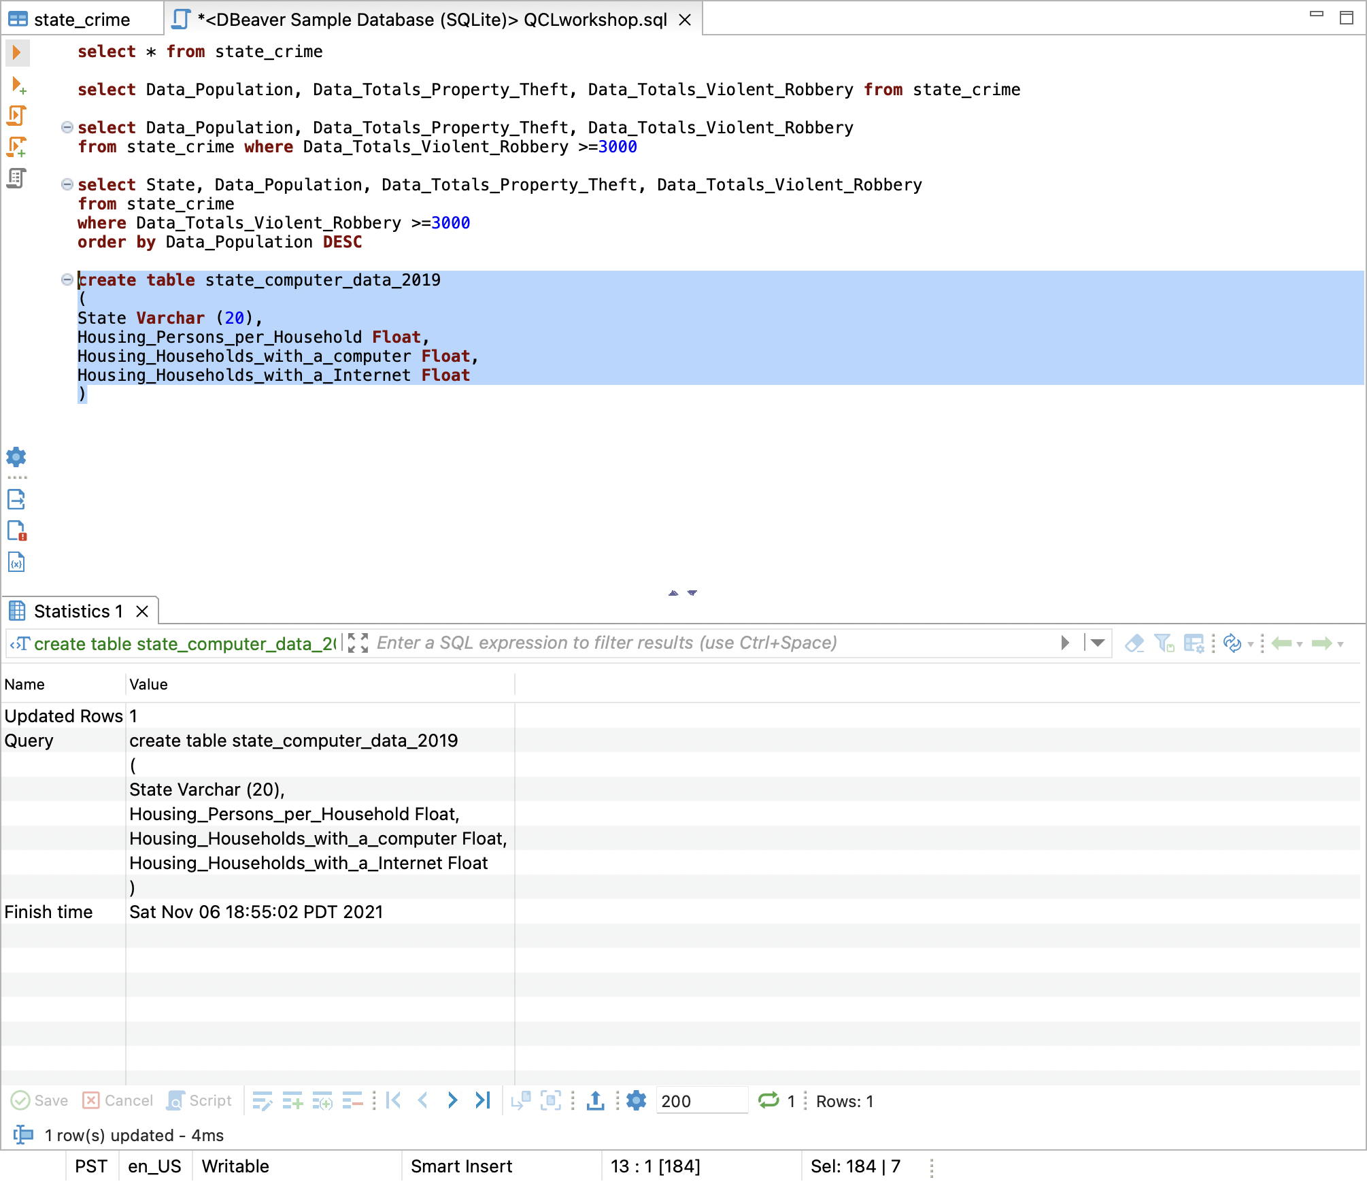
Create Table
create table state_computer_data_2019 (State Varchar (20), Housing_Persons_per_Household Float, Housing_Households_with_a_computer Float, Housing_Households_with_a_Internet Float)
insert into state_computer_data_2019 Values('Alabama', 2.55, 85.5, 76.4)
select * from state_computer_data_2019
Notes:
CREATE TABLE:
Creates a table in relational database and, depending on what database you use (e.g., MySQL), can also be used to define the table's schema
INSERT:
Inserts a row (or a set of rows) into a given table
UPDATE:
Modifies already-existing data

Slide 29
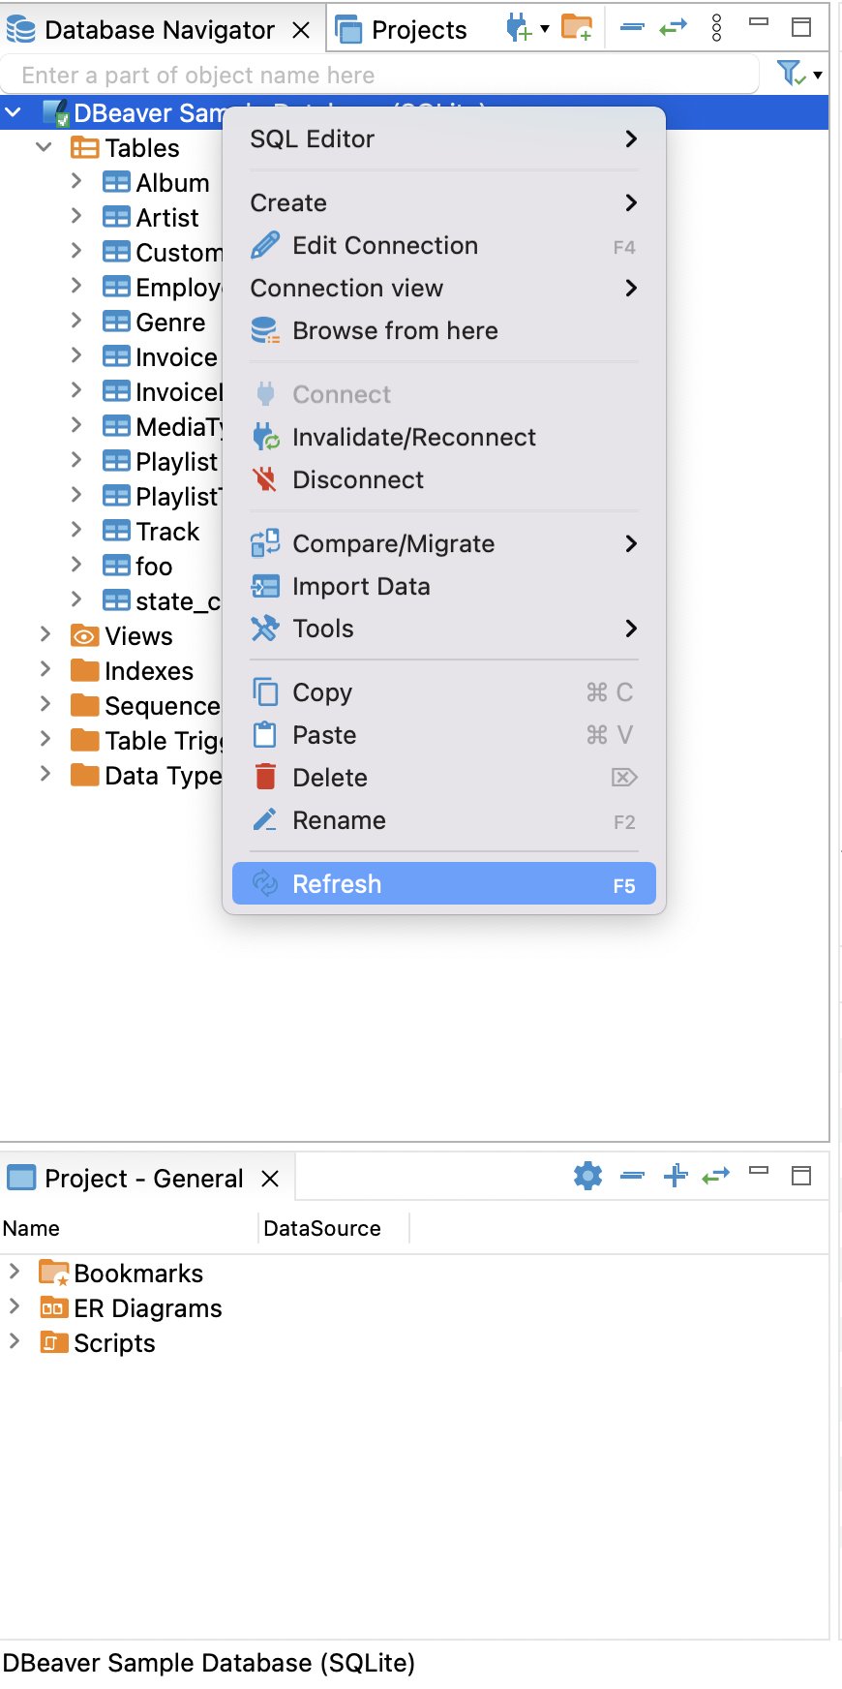
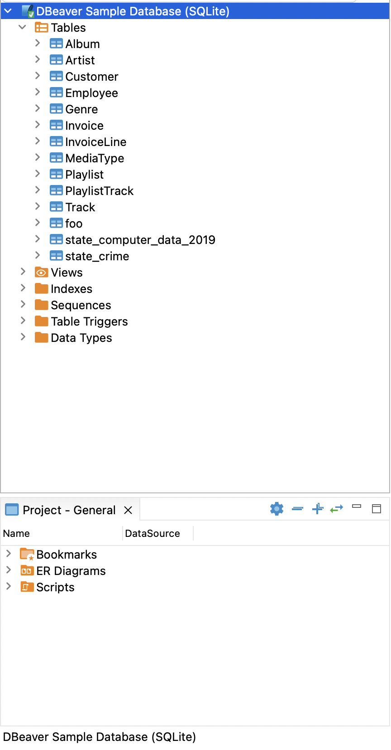
Refresh

Slide 30
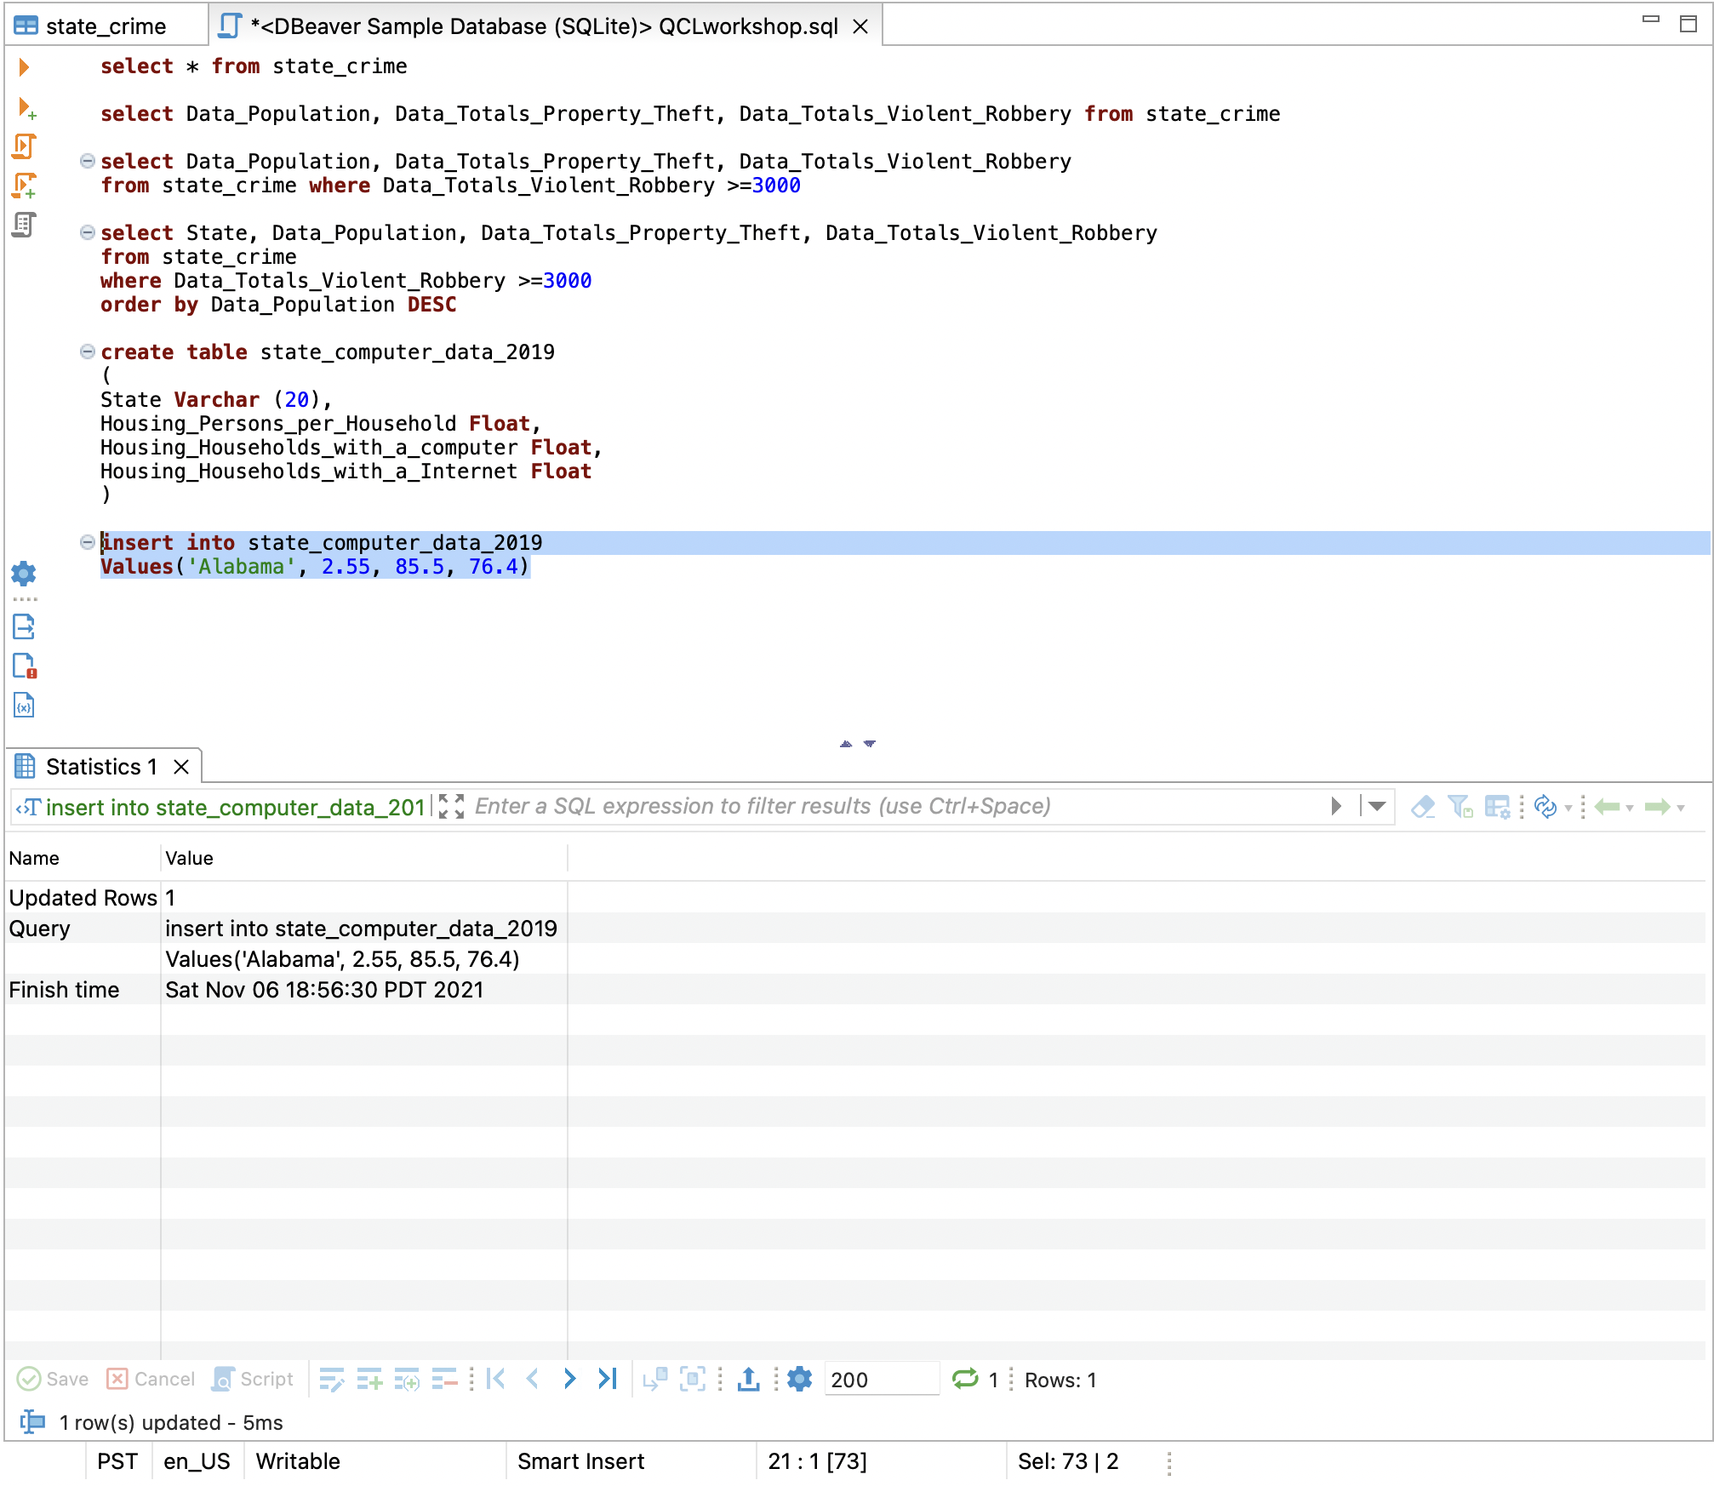
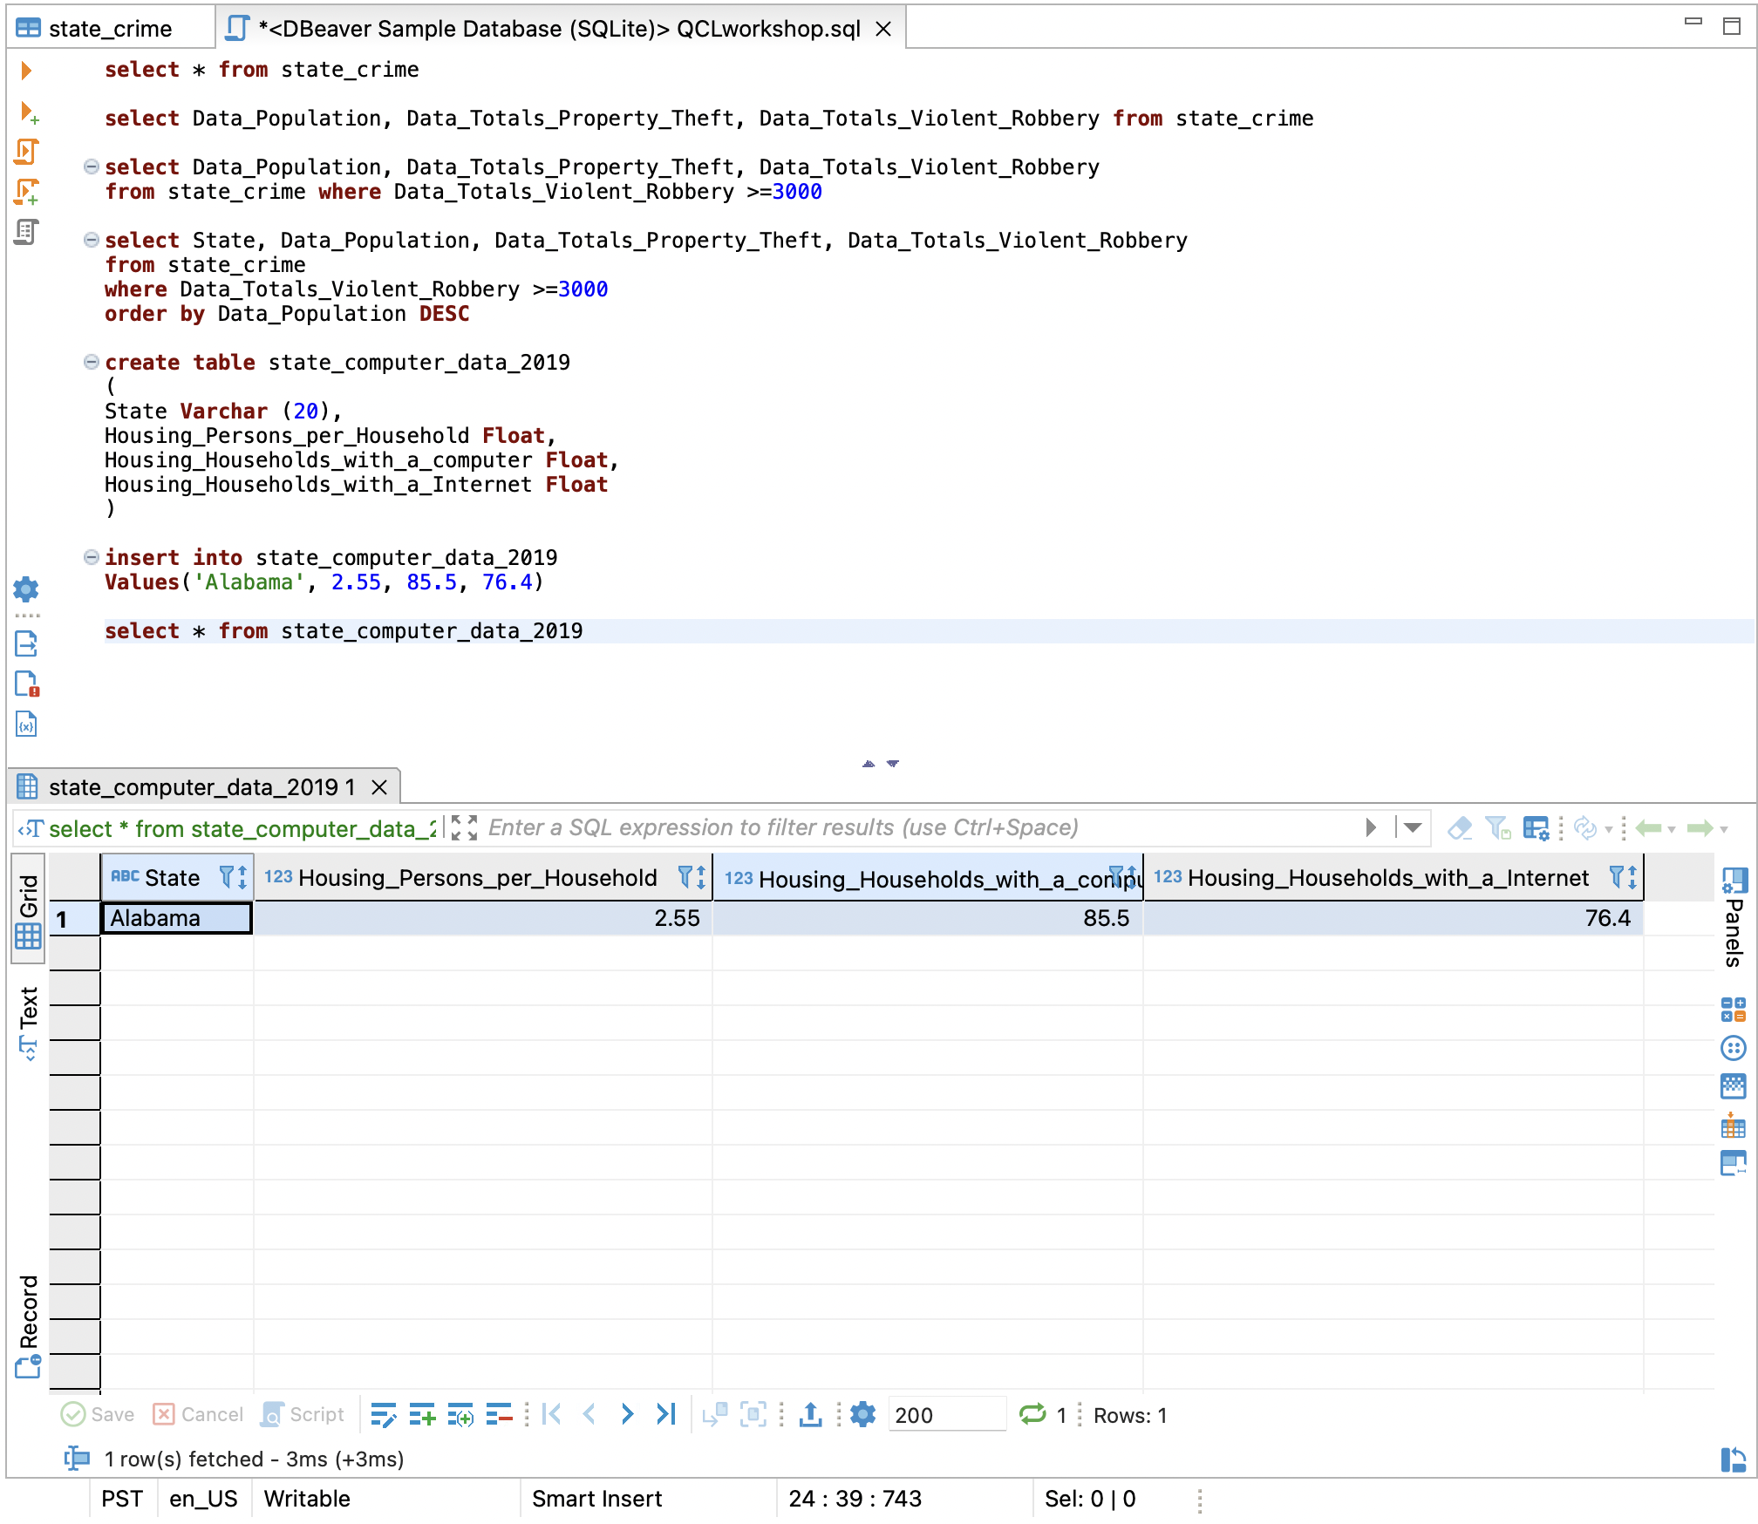
Insert data
Load state_computer_data.sql
select * from state_computer_data
Look at table data
Which column looks like a column that has the same information for covid_data?

Slide 31
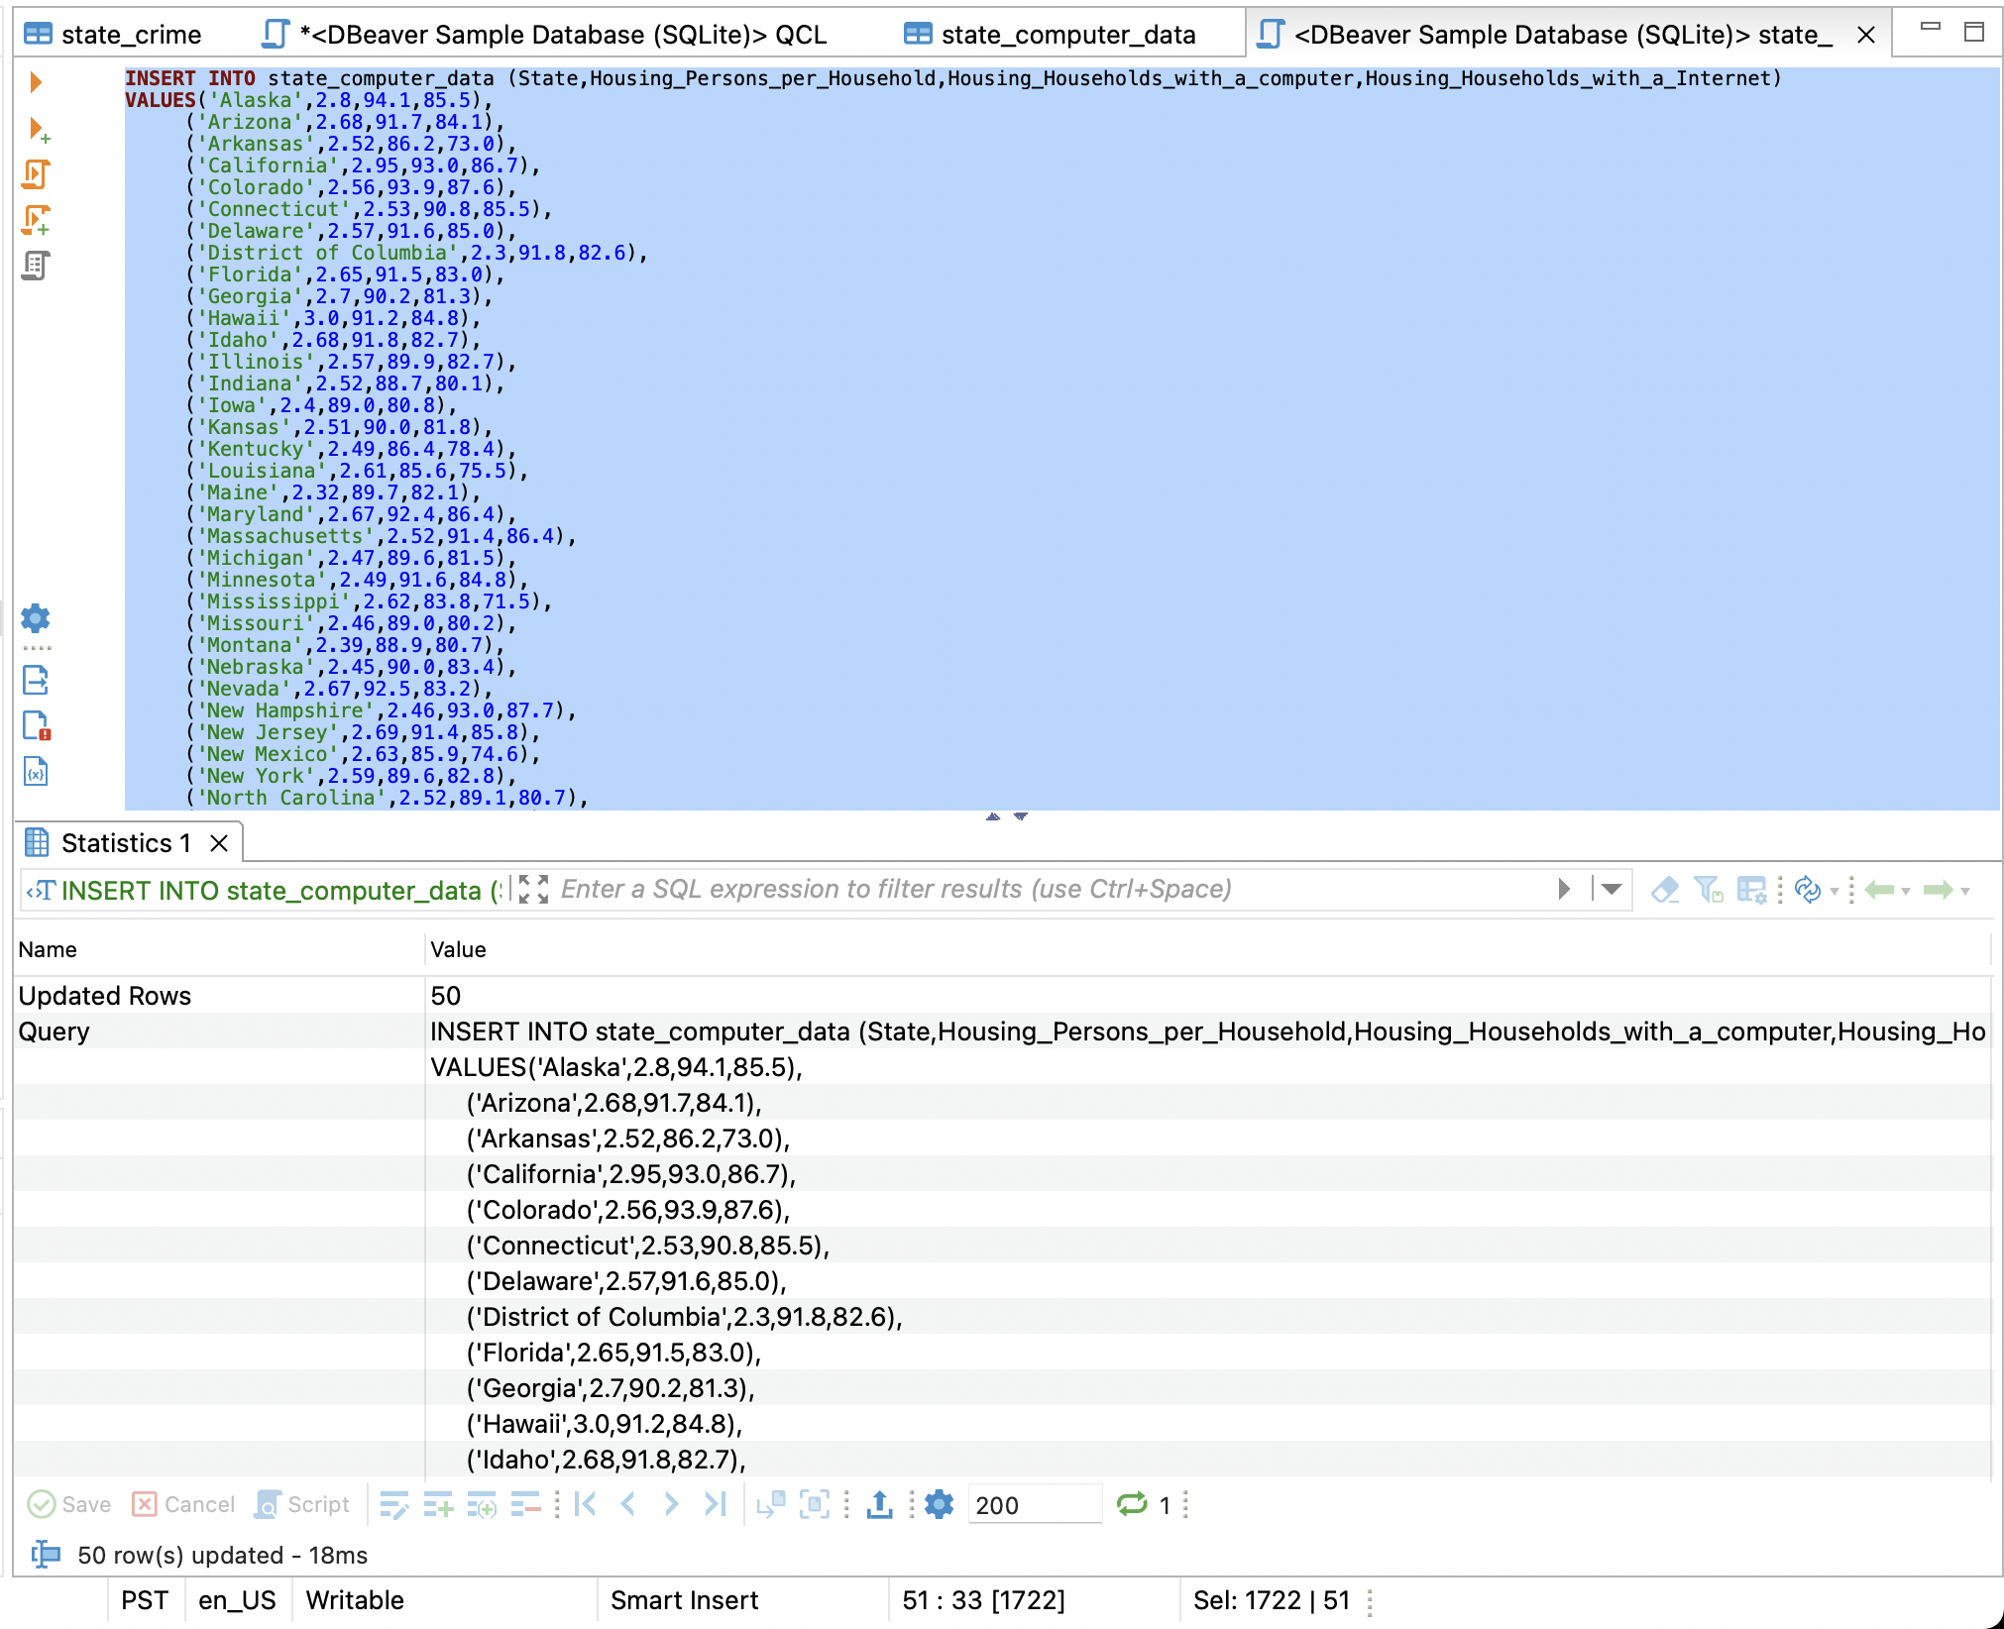
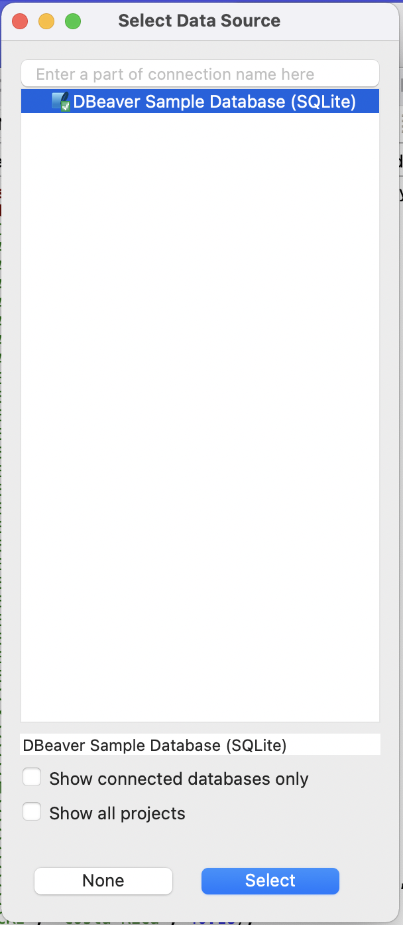
Insert data (alternative)
Click on data source
Click select

Slide 32
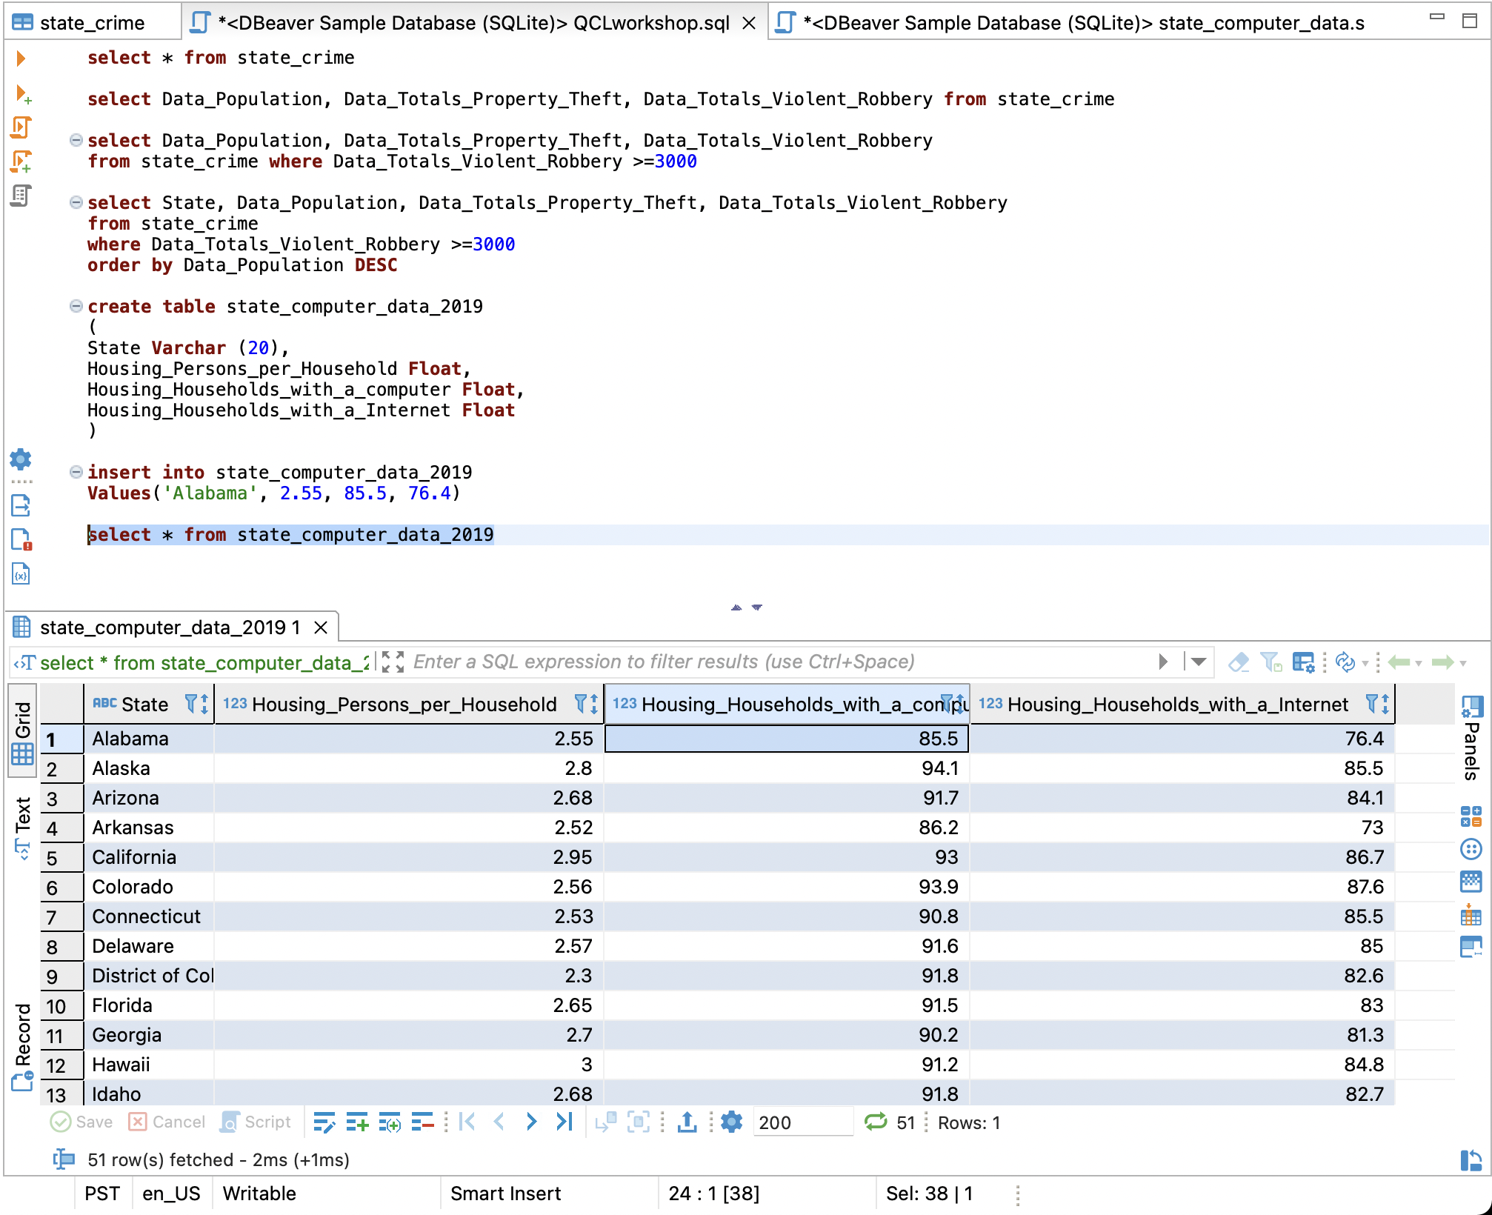
Insert data (cont.)

Slide 33
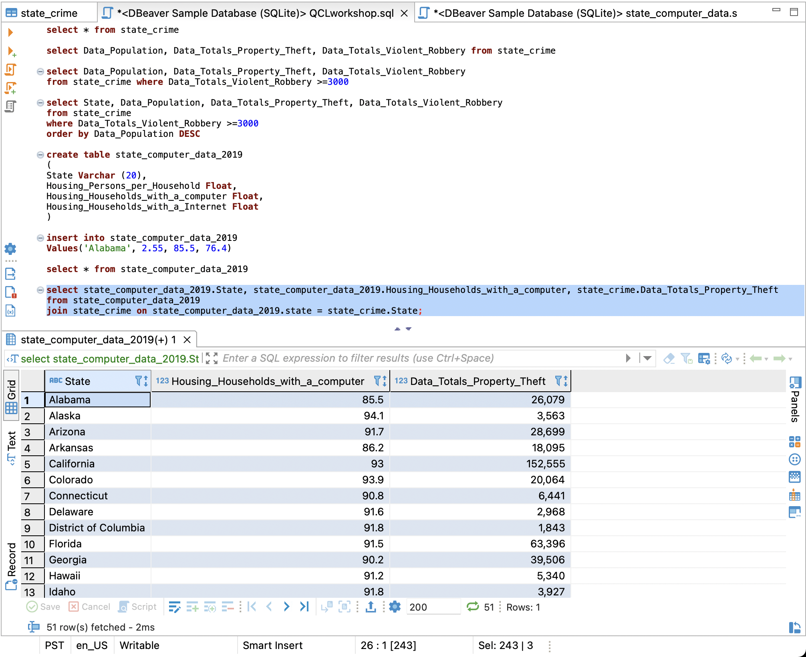
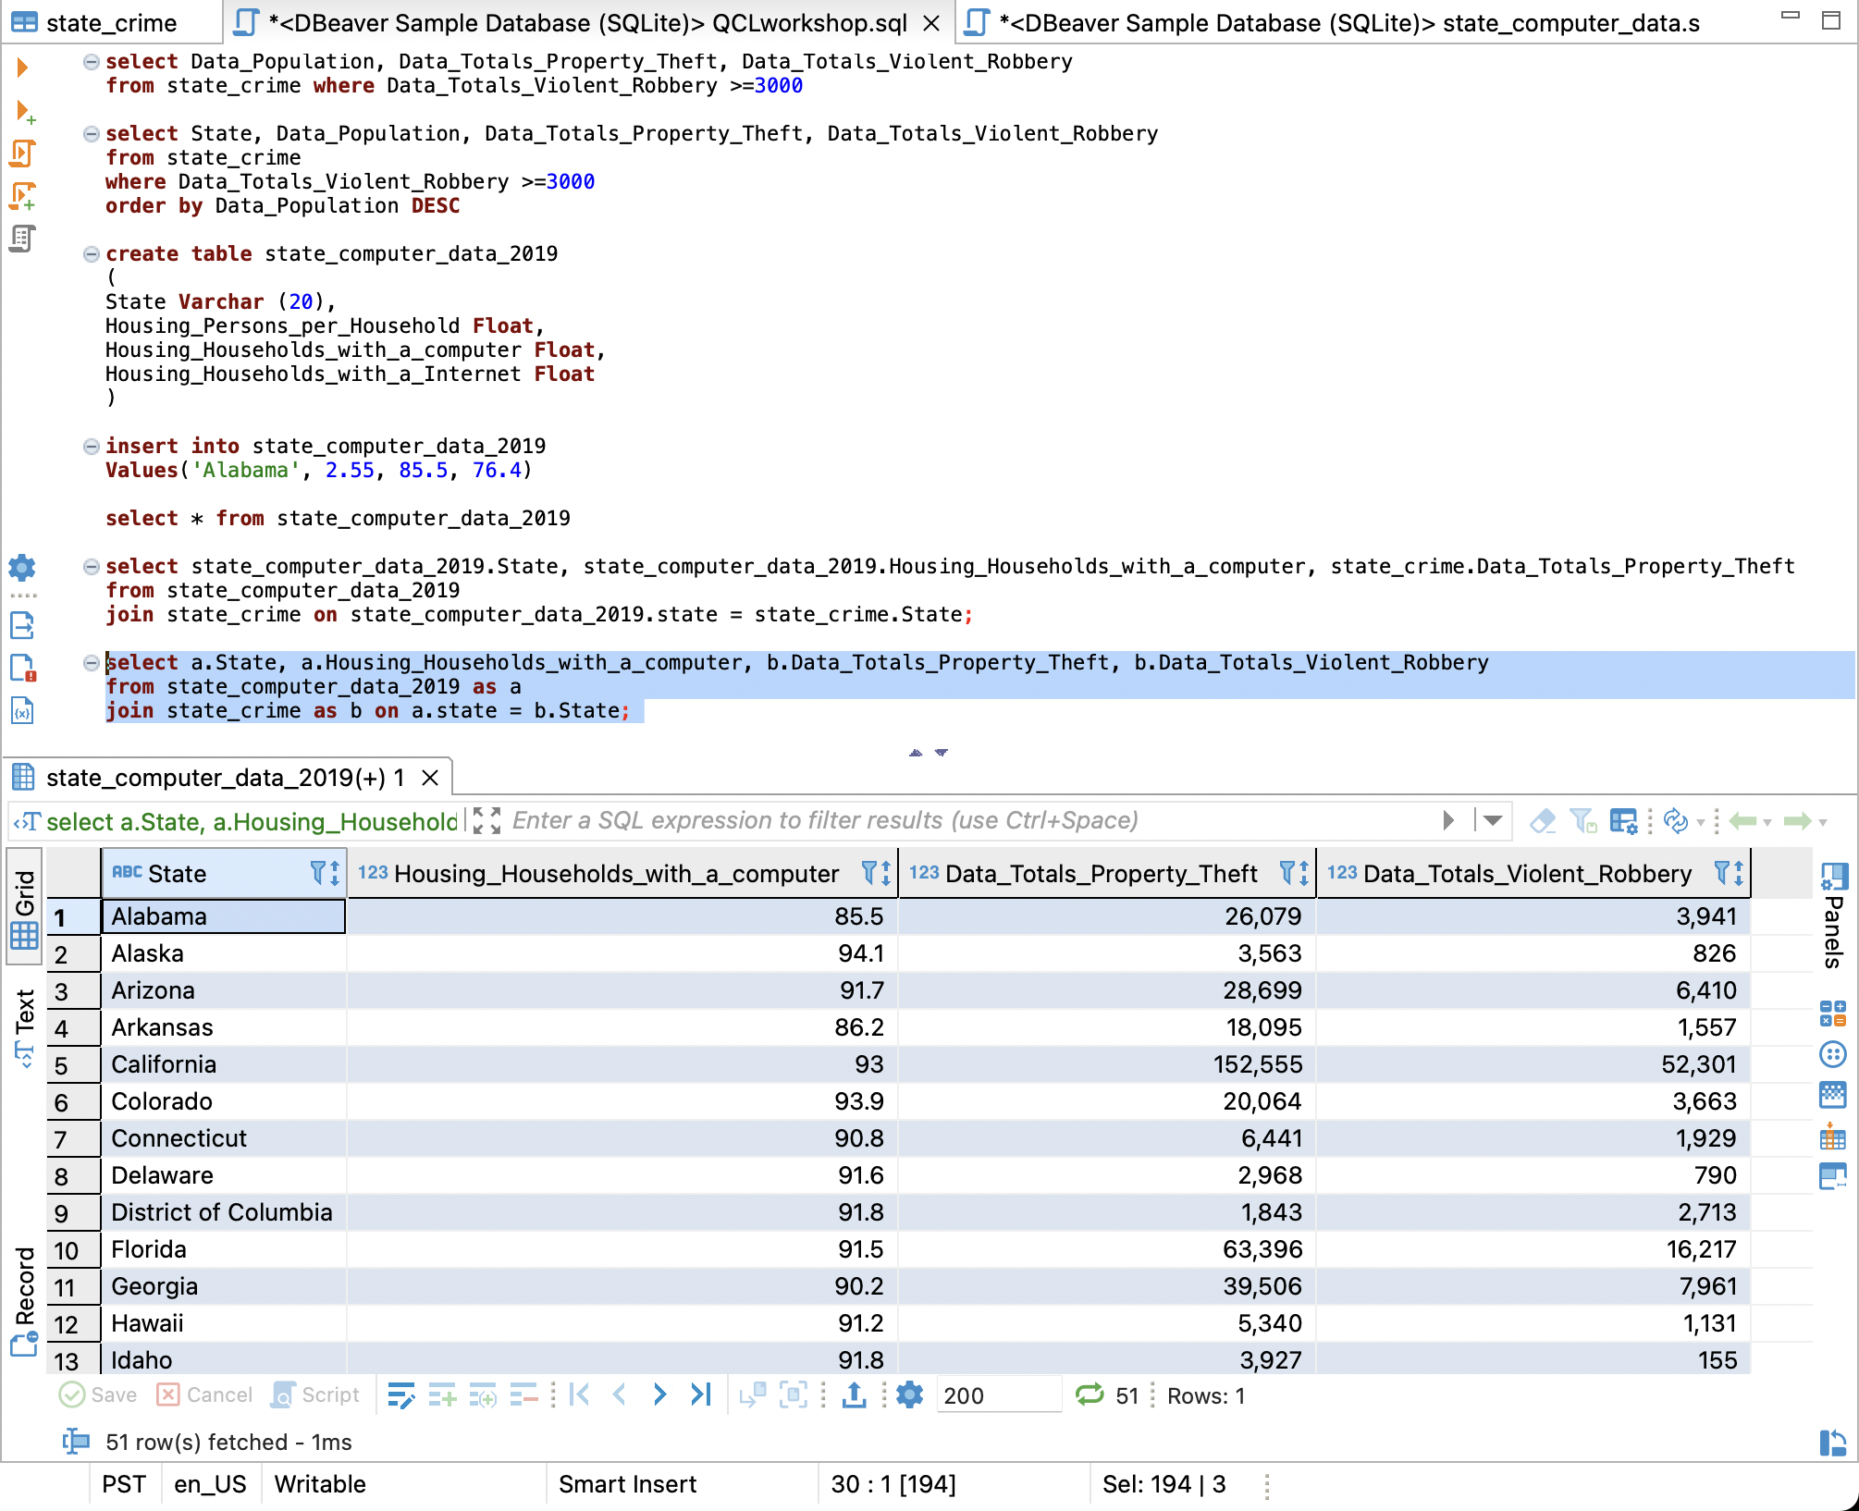
Joins and Alias
select state_computer_data_2019.State, state_computer_data_2019.Housing_Households_with_a_computer, state_crime.Data_Totals_Property_Theft from state_computer_data_2019join state_crime on state_computer_data_2019.state = state_crime.State;
Make new table that shows the data we would like to see
select a.State, a.Housing_Households_with_a_computer, b.Data_Totals_Property_Theft, b.Data_Totals_Violent_Robbery from state_computer_data_2019 as a join state_crime as b on a.state = b.State;
Give alias

Slide 34
Aggregate Functions
Notes:
DISTINCT:
Returns only distinct values
UNION:
Combines results from multiple SELECT statements
JOINS:
Inner, Outer, Left, Right
GROUP BY:
Groups/aggregates rows having the contents of a specific column or a set of columns
WHERE:
Provides a condition on which to filter before any grouping is applied
HAVING:
Provides a condition on which to filter after any grouping is applied
ORDER BY:
Sorts results in ascending or descending order according to the contents of a specific column or set of columns

Slide 35
Writing Query
Select – Returns the data that was requested
From – choose a table to draw information from
Join – matches records from different tables
Where – filters data bases on request
Group By – aggregates the data
Having – filers aggregated data
Order by – sorts the data
Limit – limit the number of rows returned

Slide 36
Operation Order
From – choose a table to draw information from
Join – matches records from different tables
Where – filters data bases on request
Group By – aggregates the data
Having – filers aggregated data
Select – Returns the data that was requested
Order by – sorts the data
Limit – limit the number of rows returned

Slide 37
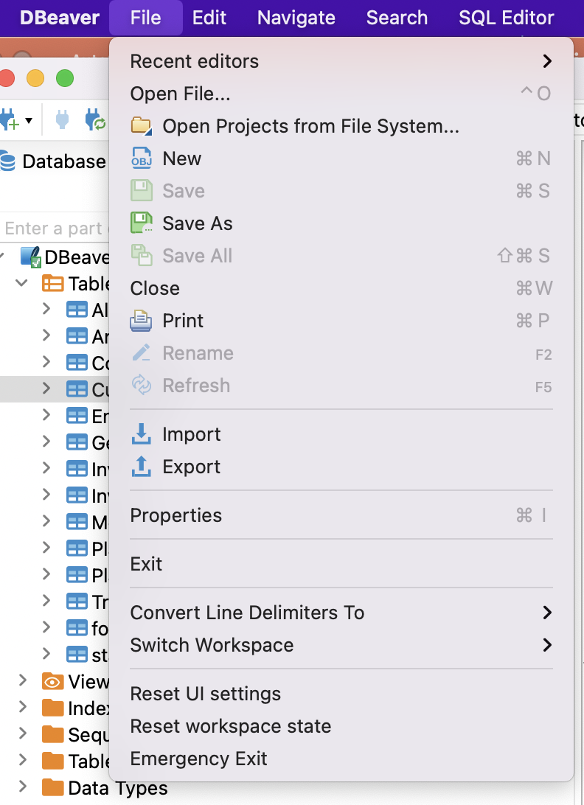
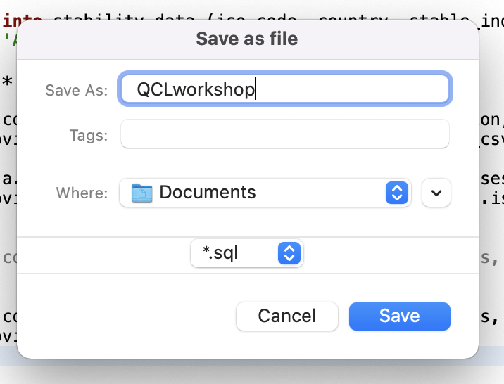
Save

Slide 38

Activity

Slide 39

Questions
From the COVID 19 Data table write queries to show the following:
What country has the highest number of total cases?
Hint: select/from/order by
What country has the smallest population density?
Hint: select/from/order by
What is the total population of the continent North America?
Hint: group by
What country has the lowest number of new cases?
Hint: group by/ order by
What country in North America has the highest number of total cases?
Hint: where

Slide 40
Answers
Let’s do it together!

Slide 41
Resources
DbeaverWiki https://github.com/dbeaver/dbeaver/wiki
W3schools -https://www.w3schools.com/sql/default.asp
CodeAcademy-https://www.w3schools.com/sql/default.asp

Slide 42
Contact info
QCL: QCL@cmc.edu
Vanessa Casillas: vanessa.casillas@claremontmckenna.edu

